Slide 1
Office of Urban Agriculture and Innovative Production Overview
Leslie Glover
OUAIP Program Manager

Slide 2
Change or Transition?
Notes:
What do you see in this picture?
What I see is change. Change like seasons can often be outside of our control but whether we decide to transition with that change is up to us.
In the slide many would probably say this young man looks a little out of season. This slide is certainly not an indictment on the young man. I think we can all acknowledge at different times in our lives we have been this young man. Change can be scary or it can be exciting, but we make the decision to stay with what is comfortable or transition with the change. Our decision to stay the same doesn’t stop the change.
My focus is more on the young ladies in the background, it looks like they have acknowledged the change, but not only did they acknowledge the change they clearly chose to transition with it. To me this picture represent some of the promise with Urban and Innovative Agriculture and why Congress found it necessary to create an Office within USDA to focus on the needs and concerns of this new and changing group of stakeholders.
Internationally the concepts and application of urban and innovative agriculture has taken off. The initial language establishing the Office was written prior to the pandemic but the pandemic is forcing us to further acknowledge change and recognize the intersection between problems like food insecurity, poor nutrition, environmental justice and human health concerns. Some of this stressors can be directly impacted by urban and innovative agriculture.
Throughout the next two days you will hear change is at-hand the question is will be able to properly transition with it.
(NEXT SLIDE)

Slide 3
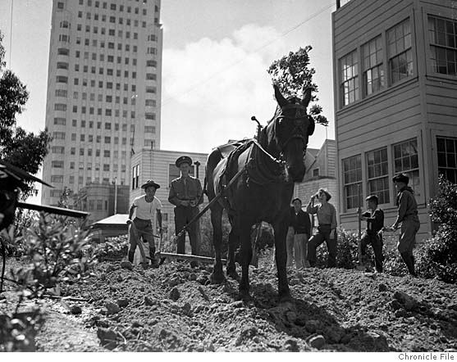
Urban Ag History
Panic of 1893 – 430 acres fed 975 families
WWI – 5 million ‘war gardens’ produced 528 million pound of food
Great Depression –gardens fed 23 million households
WWII – 20 million ‘victory gardens’ produced ½ the country’s produce
Civil Rights Era– inspired grassroots movement for food justice and sovereignty
WWII Victory Garden in San Francisco
Notes:
Urban ag and innovation in production is certainly not new. One on my colleagues often says. Globally, urban agriculture has existed for as long as there have been cities; providing food, medicinal herbs, cut flowers, and biodiversity in populated areas.
And innovation whether scientific, technological, environmental, social has been the hallmark of American Agriculture. It is the reason why American Ag has been the world leader for so long and it will be the reason we continue to lead moving forward in these arenas. A few days ago, I heard Secretary Vilsack say we are not pitting communities against one another . We want to plant a seed to increase our support for all types of agriculture with an eye toward creating more resilient food systems.
In the United States the first organized urban agriculture effort occurred during the Panic of 1893, a serious economic depression that caused high unemployment and distress on farms. As a relief measure the Mayor of Detroit, Hazen Pingree, formed an Agricultural Committee and tasked them with finding vacant lots for citizens in need of food assistance to grow their own food. In 1894, 975 families grew potatoes, beans, squash, cucumbers and more on 430 acres of 'Pengree's Potato Patches'. The produce they grew that year was valued at $14,000 which is equivalent $438,225 today. By the 1900s economic conditions in the country improved and the program tapered off.
WWI – 5 million ‘war gardens’ produced 528 million pound of food
Great Depression –gardens fed 23 million households
WWII – 20 million ‘victory gardens’ produced ½ the country’s produce
Interestingly, seventy-five years after the Pengree’s Potato Patches another Detroit mayor Coleman Young started the historic Farm A Lot Program, which set the stage for a new urban garden movement centered on food sovereignty and social justice.
Throughout the last century Americans have turned to urban agriculture during times of war and economic stress to feed themselves and their communities. In recent years, urban agriculture has been revived by communities facing food related illness and food insecurity. Today urban agriculture is colored by the slow food movement, sustainability, environmental stewardship, food security and accessibility, community empowerment, and cultural diversity. The current urban agriculture movement is still using vacant lots for food production, but they have also expanded to hydroponics, aquaponics, container gardening, and commercial food production.
The picture above is a horse plowing a Victory Garden around the era of WWII in San Francisco.
(NEXT SLIDE)

Slide 4
1976 Urban Garden Program
Funded over $23 million in projects in 16 cities with over 300,000 participants between 1976 thru 1993
Notes:
The USDA has also had a hand in moving the urban and innovative agriculture movement forward. In 1969 the USDA established the first Urban Conservation District in Washington, DC..
In 1976 the USDA established the Urban Garden Program under the Cooperative Extension Service to support existing community gardens, The purpose of the program was to reconnect urban citizens with agriculture, increase the interest in gardening, the opportunity to encourage house production and home economic practices, and offer jobs to urban youth.
The program ran from 1976-1993 and awarded $23M in projects and at its height enrolled over 300,000 participants. At its height in 1986 it is estimated the projects were producing $17M worth of producer per year.
(NEXT SLIDE)

Slide 5
1994 Urban Resources Partnership
Funded over 200 awards in 13 cities worth $20 million between 1994 thru 1999.
Notes:
In 1994 the USDA established the Urban Resources Partnership. The program was managed by USDA Forest Service and Natural Resources Conservation Services and provided support for activities such as
flower and vegetable gardens,
compost areas,
tree and shrub planting,
build trails in local parks,
create murals,
educational programs
urban habitat classrooms
large-scale dry land farming
and neighborhood cleanup.
The program funded over 200 awards in 13 cities worth $20 million between 1994 and 1999.
(NEXT SLIDE)

Slide 6
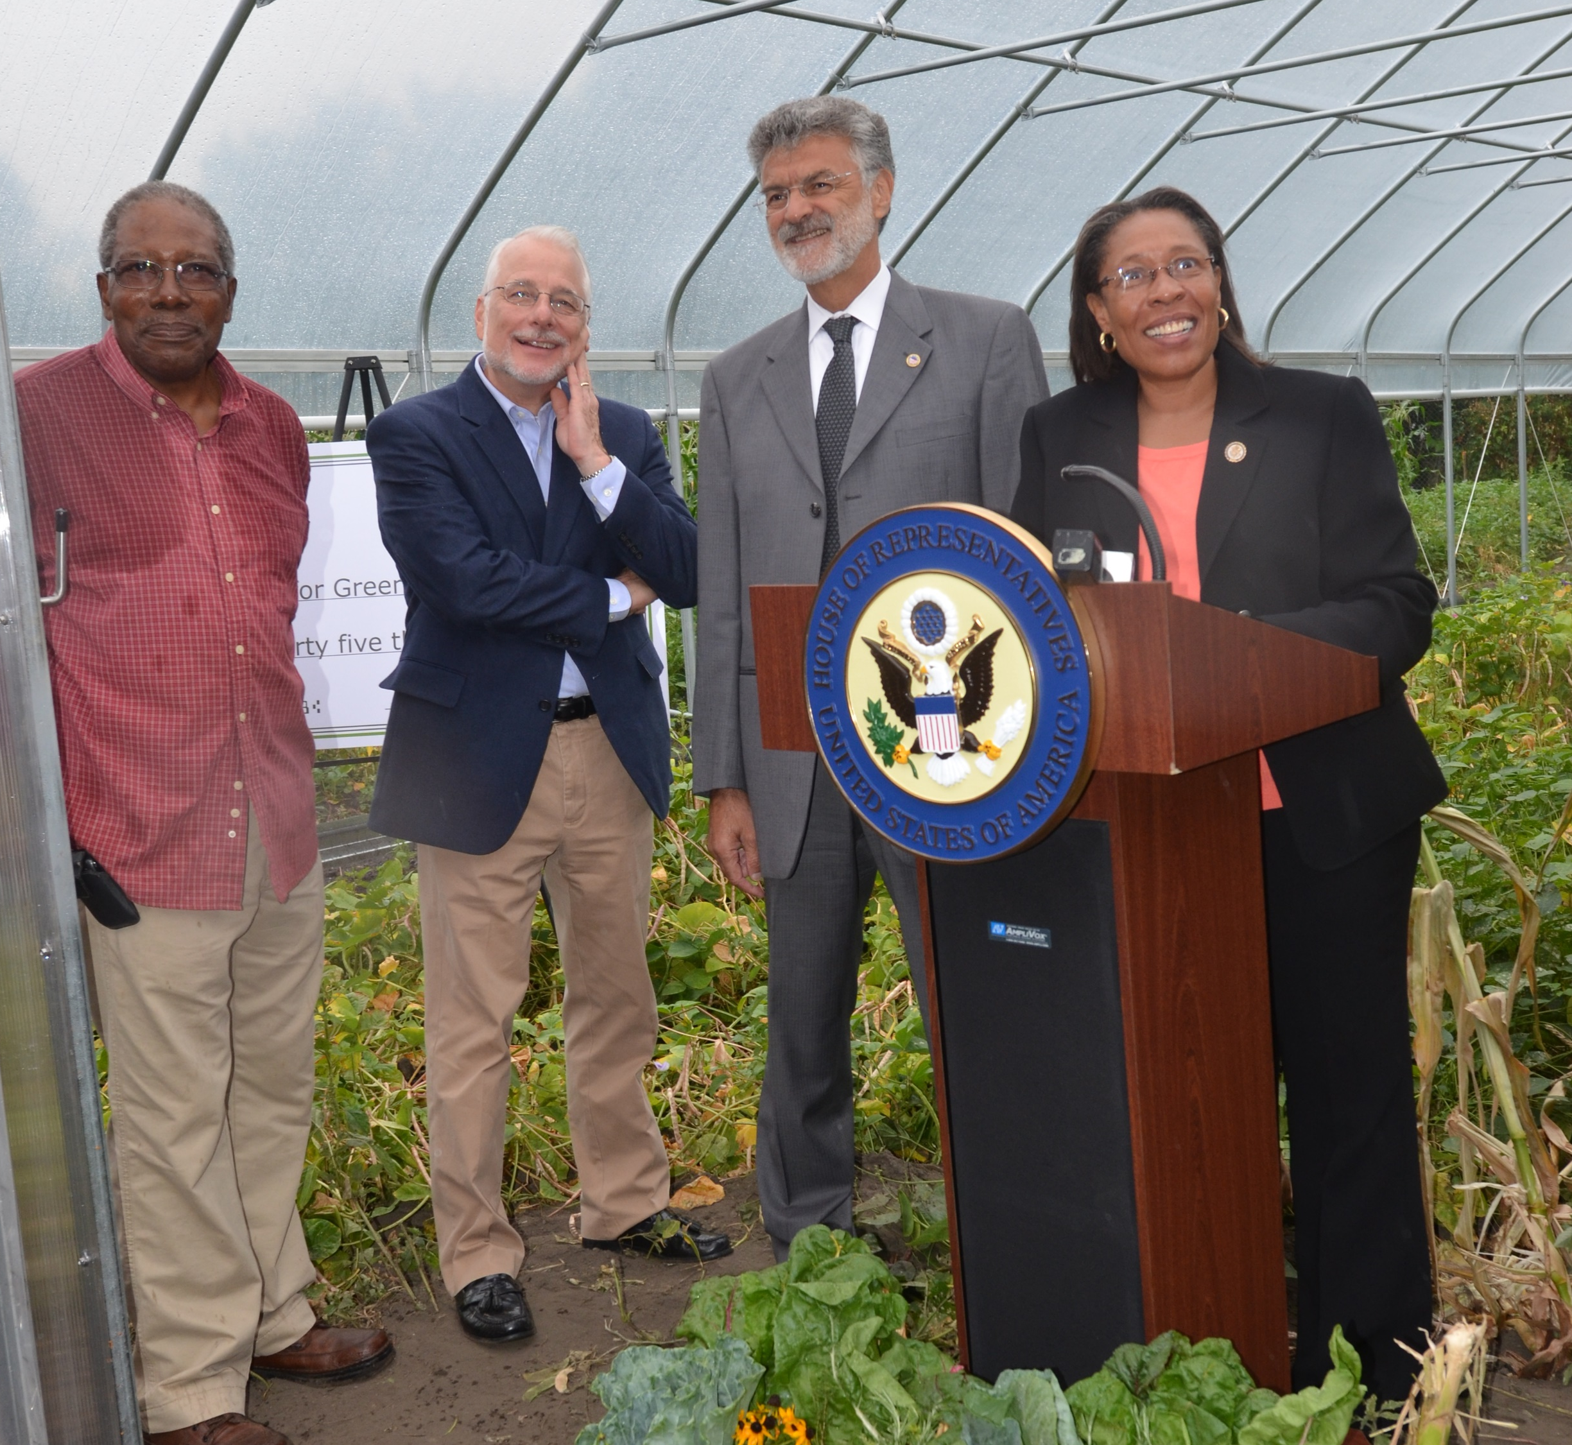
2018 Farm Bill History
2018 Farm Bill created the Office of Urban Agriculture and Innovative Production (OUAIP)
Secretary Fudge was instrumental in writing the legislation as Representative of Ohio's 11th District
Notes:
Fast forward to the 21 century with the creation of the Farm Bill
The current Secretary of Housing and Urban Development Marcia Fudge was instrumental in writing the 2018 Farm Bill during her time as the Representative of Ohio's 11th District. The Farm Bill went on to create the USDA’s Office of Urban Agriculture and Innovative Production (OUAIP).
(NEXT SLIDE)

Slide 7
Background
Under the leadership of Sec. Vilsack and Sec. Fudge, USDA expanded the services it offered in urban areas
Cleveland Urban Hoop House Pilot Project
Notes:
Under the leadership of Secretary Vilsack and Secretary Fudge, the USDA started a pilot project to expand the services offered in urban areas in 2011-2012.
Then Congresswoman Fudge had a vision to create an urban agriculture movement in Cleveland that would reduce food insecurity and help change the narrative of the city. She led major push for a pilot project that encouraged urban farmers to apply for technical and financial assistance to purchase and construct Seasonal High Tunnels, also known as “hoop houses.” Hoop houses extend the growing season and allow farmers to provide fresh local produce for more months of the year.
(NEXT SLIDE)

Slide 8
Cleveland High Tunnel Initiative
NRCS Chief Terry Cosby was the Ohio State Conservationist
He was the first Conservationist to fund hoop houses in urban areas
NRCS built more than 80 in the Cleveland area between 2011-2012
Notes:
The technical and financial assistance for the hoop houses in Cleveland was provided by NRCS.
Current NRCS Chief Terry Cosby was the Ohio State Conservationist at the time, and was the first State Conservationists to fund hoop houses in urban areas. More than 80 hoop houses in the greater Cleveland area were built between 2011-2012.
Beyond simply offering hoop house assistance, this pilot project also undertook efforts to bring in a range of partners and stakeholders to make USDA services more accessible to the community. Targeted efforts were made to ensure that program lingo not commonly understood outside of USDA would be translated into ordinary language so that community members could apply for the benefits and services available to them. Efforts were also made to help farmers navigate the permits and processes to obtain leases, building permits, and access to water, which can be daunting and at times detour people from chasing their dreams of becoming an urban farmer. The pilot project also trained local youth to build and install high tunnels, giving young people the tools to better their community or acquire professional skills, which can be life changing.
This full-service model created by the Cleveland pilot project is the basis for the work of the Office of Urban Agriculture and Innovative Production.
(NEXT SLIDE)

Slide 9
Congress’s Intent for the Office
To be responsible for policy and program development.
To use these grants to assist with costs
Pilot projects not inhibit commercial food waste recovery efforts
Projects consider the Food Recovery Hierarchy
Notes:
In 2018 Congress recognized that urban agriculture and innovative production methods like indoor and rooftop farming create new economic opportunities in urban, suburban, and rural communities.
They also recognized that some USDA agencies such as NRCS that were already doing work in these areas and wanted to create more cohesion in the USDA vision.
The intent was for the office to
be responsible for policy and program development, as well as interagency collaboration, and provide customer service to external stakeholders on issues pertaining to urban agriculture and innovative production.
to use these grants to assist with costs related to agricultural production including but not limited to land acquisition, equipment, utilities, seeds and plants, supplies, basic transportation, and farm cooperative development
Congress also recognized the issue of food waste around the world. Roughly 1/3 of food produced for human consumption is lost or wasted globally from farm to fork (FAO), amounting to around 1.3 billion tons/year.
Our Composting pilot is way to recognize that composting is just one aspect to food waste recovery but that other technologies are available for food waste recovery. Therefore, the USDA pilots related to compost and food waste reduction do not adversely impact existing commercial relationships of other food waste recovery efforts, including those of commercial renderers who collect and process animal and food waste from commercial and farm sources. And they should take into consideration the most-preferred food waste recovery activities as described in the Food Recovery Hierarchy of the Environmental Protection Agency
(NEXT SLIDE)

Slide 10
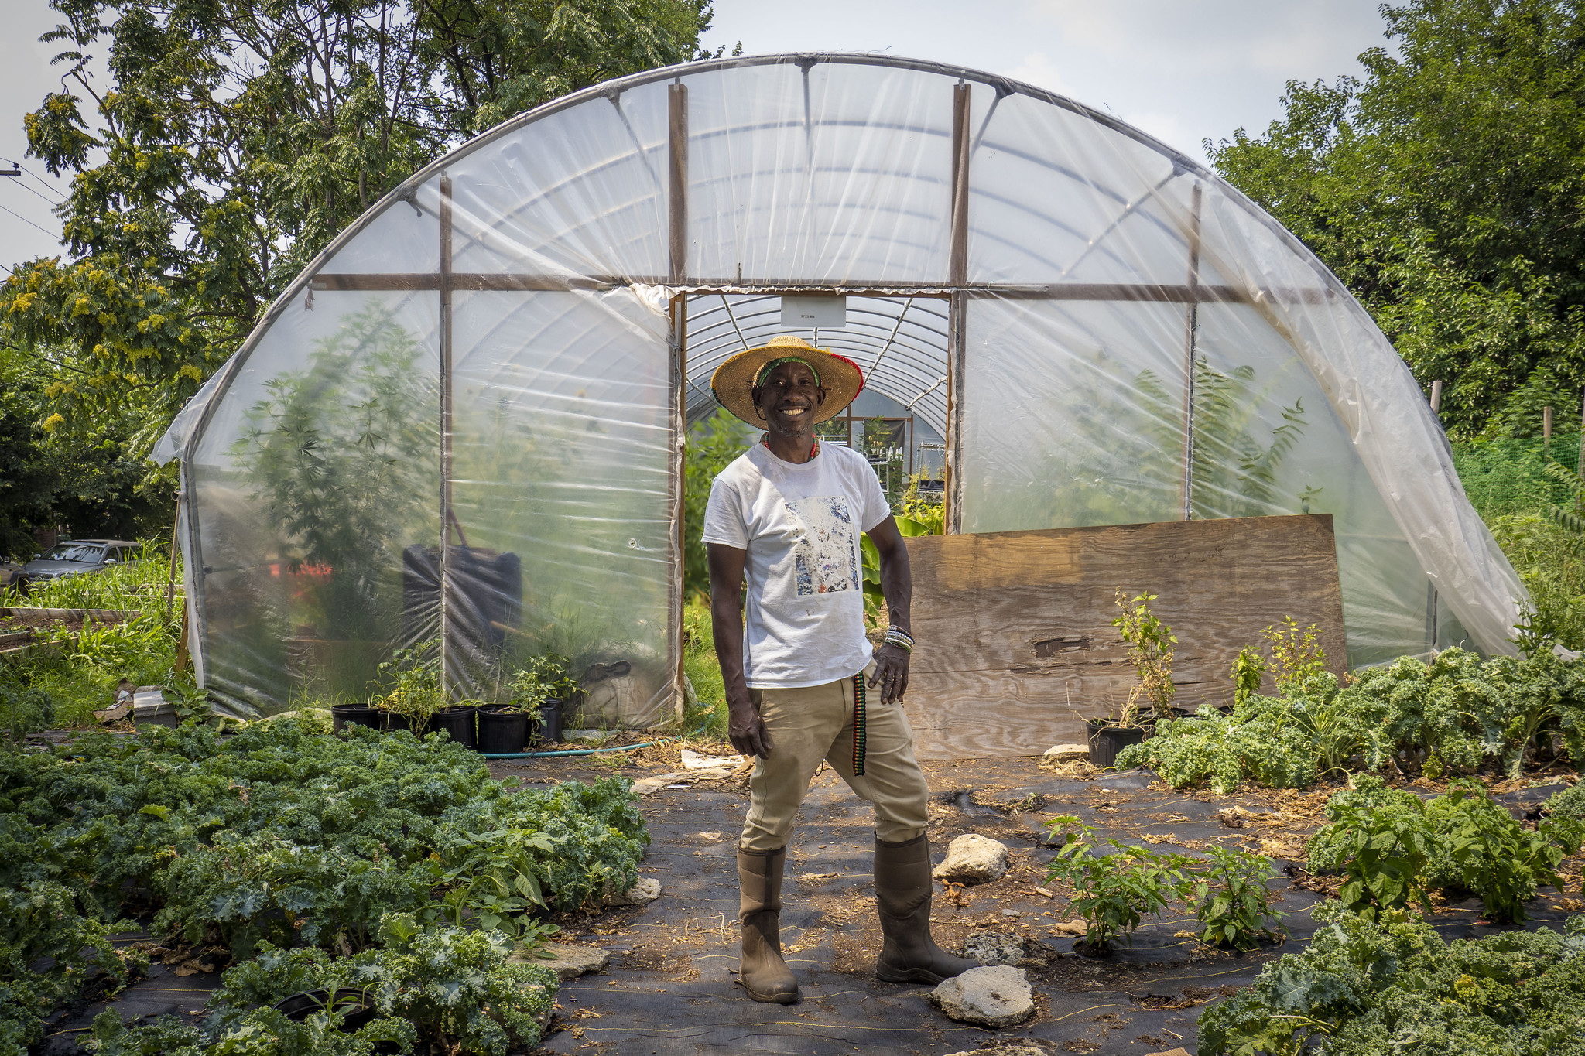
To Help People,
We Must Reach People
Success hinges on acceptance and engagement from local communities
Notes:
The success of our urban outreach efforts and initiatives will hinge on acceptance and engagement from the local communities.
Which is where this Federal Advisory Committee and engagement from public comes in.
(NEXT SLIDE)

Slide 11
What is OUAIP?
Office of Urban Agriculture and Innovative Production
Urban Agriculture and Innovative Production Federal Advisory Committee
Pilots: Urban and Suburban County Committees
Pilot: Community Compost and Food Waste Reduction Projects
Urban Agriculture and Innovative Production (UAIP) Competitive Grants Program
Notes:
What is the OUAIP? We are the Office of Urban Agriculture and Innovative Production.
The mission of the Office is to encourage and promote urban, indoor, and other emerging agricultural practices, including:
(A) community gardens and farms located in urban areas, suburbs, and urban clusters;
(B) rooftop farms, outdoor vertical production, and green walls;
(C) indoor farms, greenhouses, and high-tech vertical technology farms;
(D) hydroponic, aeroponic, and aquaponic farm facilities; and agroforestry, food forests and urban orchards; and
(E) other innovations in agricultural production.
Our Office works under the banner of NRCS it works across the Department on issues of urban and innovative production. When the Office was first established it did not have a home, so the FPAC Undersecretary at the time Bill Northey stepped up and took on the responsibility to get the Office started.
Our office has several authorities that we administer:
1. Urban Agriculture and Innovative Production Federal Advisory Committee (which my colleague Tammy Willis will discuss in the next session)
2. Urban Agriculture and Innovative Production Competitive Grants Programs
3. Pilot: Community Compost and Food Waste Reduction Projects
4. Pilot: Urban and Suburban County Committees
I will now take a little deeper dive into some of our authorities
(NEXT SLIDE)

Slide 12
Urban/Suburban County Committees
Notes:
In coordination with the Farm Service Agency, OUAIP has helped stand up 11 pilot Urban County Committees across the country. These committees are elected by local urban farmers and provide a voice for urban farmers in the administration of USDA programs.
To expand on this work being done by Urban County Committees, OUAIP plans to open offices in these 11 cities and has been working with agencies from across the USDA to pull together programs and services available to assist urban farmers. The office is also working with NRCS to develop technical and financial assistance tailored to meet the needs of urban farmers.
There will be another phase of locations rolled out in 2022.
(NEXT SLIDE)

Slide 13
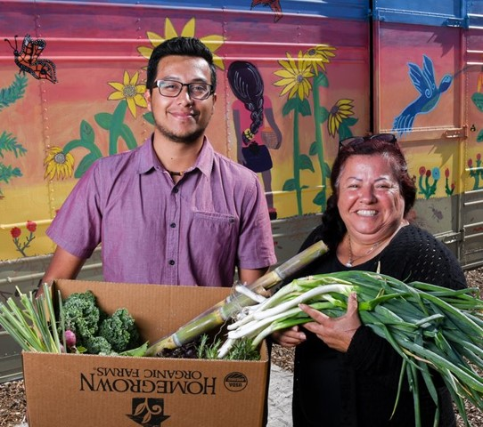
Funding Opportunities
Composting and Food Waste Reduction Cooperative Agreements (CFWR)
Urban Agriculture and Innovative Production (UAIP) Competitive Grants
Notes:
(Image: Durham, NC Farmers Market, fresh flower stand, Stuart Lee, USDA Local Foods Local Place Plan)
Funding Opportunities:
Community Compost and Food Waste Reduction (CCFWR) Cooperative Agreements
Urban Agriculture and Innovative Production (UAIP) Grants
Community Compost and Food Waste Reduction (CCFWR) Cooperative Agreements
Offered through a competitive process to municipalities, counties, local governments, or city planners to carry out planning and implementing activities to develop and test municipal compost plans and food waste reduction plans
Urban Agriculture and Innovative Production (UAIP) Grants
support urban agriculture and innovative production activities were offered to eligible applicants to fund planning and implementation projects.
Focus on urban and suburban areas where access to fresh foods is limited or unavailable

Slide 14
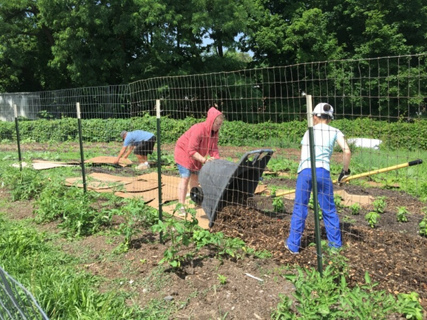
Composting and Food Waste Reduction Agreements
Competitive process for planning and implementing municipal compost plans and food waste reduction plans.
Eligibility limited to entity types:
City or township governments
County governments
School Districts
Native American Tribal governments
Native American Tribal organizations
Special district governments
Municipal Governments
Notes:
Compost and Food Waste Reduction (CCFWR) Project cooperative agreements assist local and municipal governments with projects that develop and test strategies for planning and implementing municipal compost plans and food waste reduction plans. Implementation activities will increase access to compost for agricultural producers, improve soil quality and encourages innovative, scalable waste management plans that reduce and divert food waste from landfills. Another change that is in the works is updating the eligibility for tribal governments.
1) generate compost;
2) increase access to compost for agricultural producers;
3) reduce reliance on, and limit the use of, fertilizer;
4) improve soil quality;
5) encourage waste management and permaculture business development;
6) increase rainwater absorption;
7) Reduce municipal food waste; and
8) divert food waste from landfills.
(NEXT SLIDE)

Slide 15
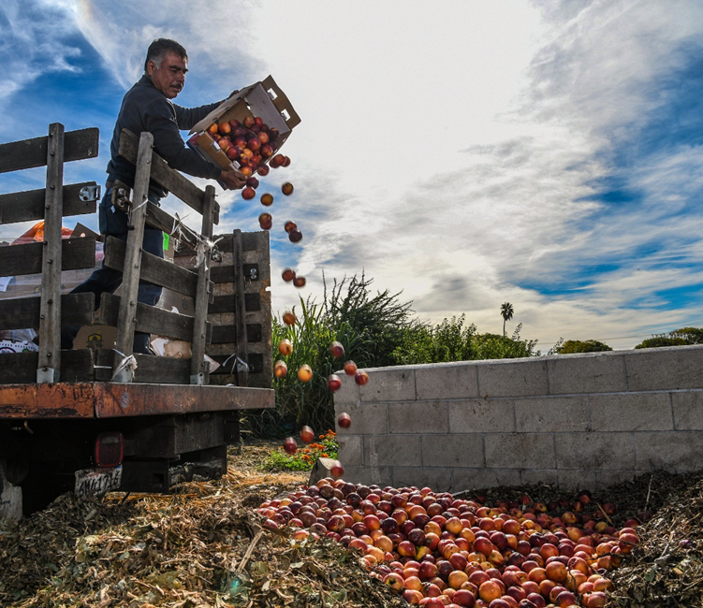
Compost and Food Waste Reduction Agreements
Funded 37 cooperative agreements worth $3 million in 2020 and 2021 combined
Notes:
This program has funded 37 cooperative agreements worth $3 million in 2020 and 2021 combined, but we have had over 150 applicants. There has been a lot of interest in this funding opportunity.
(NEXT SLIDE)
Examples of CCFWR Accomplishments
Lake County, IL.: Finalizing an empirical study of composting applications on county farmland and community gardens for increased crop productivity and organic content
Anchorage, AK.: Collected food scraps from over 1400 homes in feasibility/pilot project for local composting; helping reduce costs associated with transporting municipal waste to nearest landfill over 40 miles away; the project estimates that as much as 25% of landfill waste in Anchorage can be composted.
Prince William County, VA.: Processed/diverted over 16,000 lbs. of food waste/scraps from landfills from six schools in three months; will be converted to compost to be used for school gardens
Restore Colorado; Boulder, CO.: In one year, applied 1,262 cu yd of compost originating from food waste accessed via partnerships with 27 restaurants/business that accepted a short-term 1% surcharge that generated an additional $100,000 in additional project funding
New York City, NY.: The NYC Dept of Sanitation Recycling and Sustainability has collected and processed over 1 million lbs. of food scrap drop-offs at twenty community gardens delivered by an estimated 181,000 participants. The project has distributed approximately 236 cu yd of compost and ‘browns’ to urban ag producers and community gardens.

Slide 16
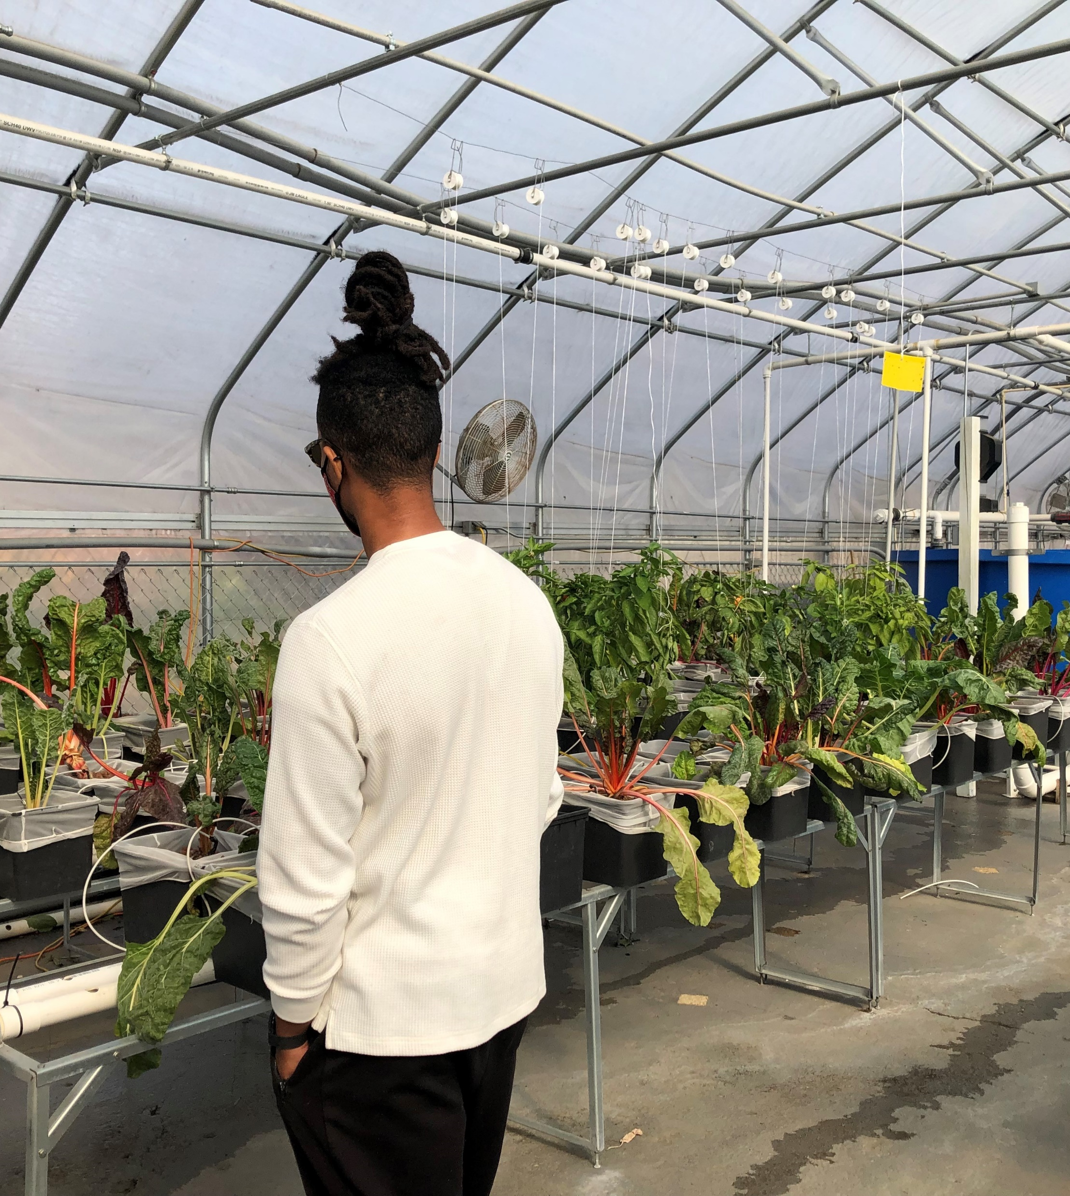
Urban Agriculture and Innovative Production Grants
Support planning and implementation projects
Focus on urban and suburban areas where access to fresh foods is limited or unavailable.
Eligible applicants:
nonprofit organizations
units of local government
tribal governments
schools that serve grades K-12
Notes:
The Competitive Grants Program supports a wide range of activities through two grant types: Planning Projects and Implementation Projects. Activities include operating community gardens and nonprofit farms, increasing food production and access in economically distressed communities, providing job training and education, and developing business plans and zoning.
Planning Projects initiate or expand efforts of farmers, gardeners, citizens, government officials, schools and other stakeholders in urban areas and suburbs. Projects may target areas of food access, education, business and start-up costs for new farmers and development of policies related to zoning and other needs of urban production.
Implementation Projects accelerate existing and emerging models of urban, indoor and other agricultural practices that serve multiple farmers. Projects will improve local food access and collaborate with partner organizations and may support infrastructure needs, emerging technologies, educational endeavors and urban farming policy implementation.
Awarded Project -- Planning
Location State Project Title
City of New Haven Connecticut The New Haven Urban Agriculture Master Plan
Center for Land-Based Learning California Urban Agriculture Assessment and Recommendations
Feast Down East North Carolina Community Learning Farm Planning Project
Awarded Projects - Implementation
Location State Project Title
NY Sun Works New York Urban Hydroponic Agriculture in NYC Public School Classrooms
Association of Africans Living in Vermont Vermont New Farms for New Americans: Improving Lands, Improving Lives
Arkansas Interfaith Power and Light Arkansas Building a Network of Growers to Improve Access to Local Food
Famicos Foundation Ohio Grow Glenville Famicos
The Greenleaf Foundation Georgia Eastside Hyper-Local Food System Project
Common Ground Producers and Growers Kansas Common Ground Urban Innovation Project
Parkside Business & Community in Partnership New Jersey The Camden Urban Agriculture Leadership Pipeline Project
(NEXT SLIDE)

Slide 17
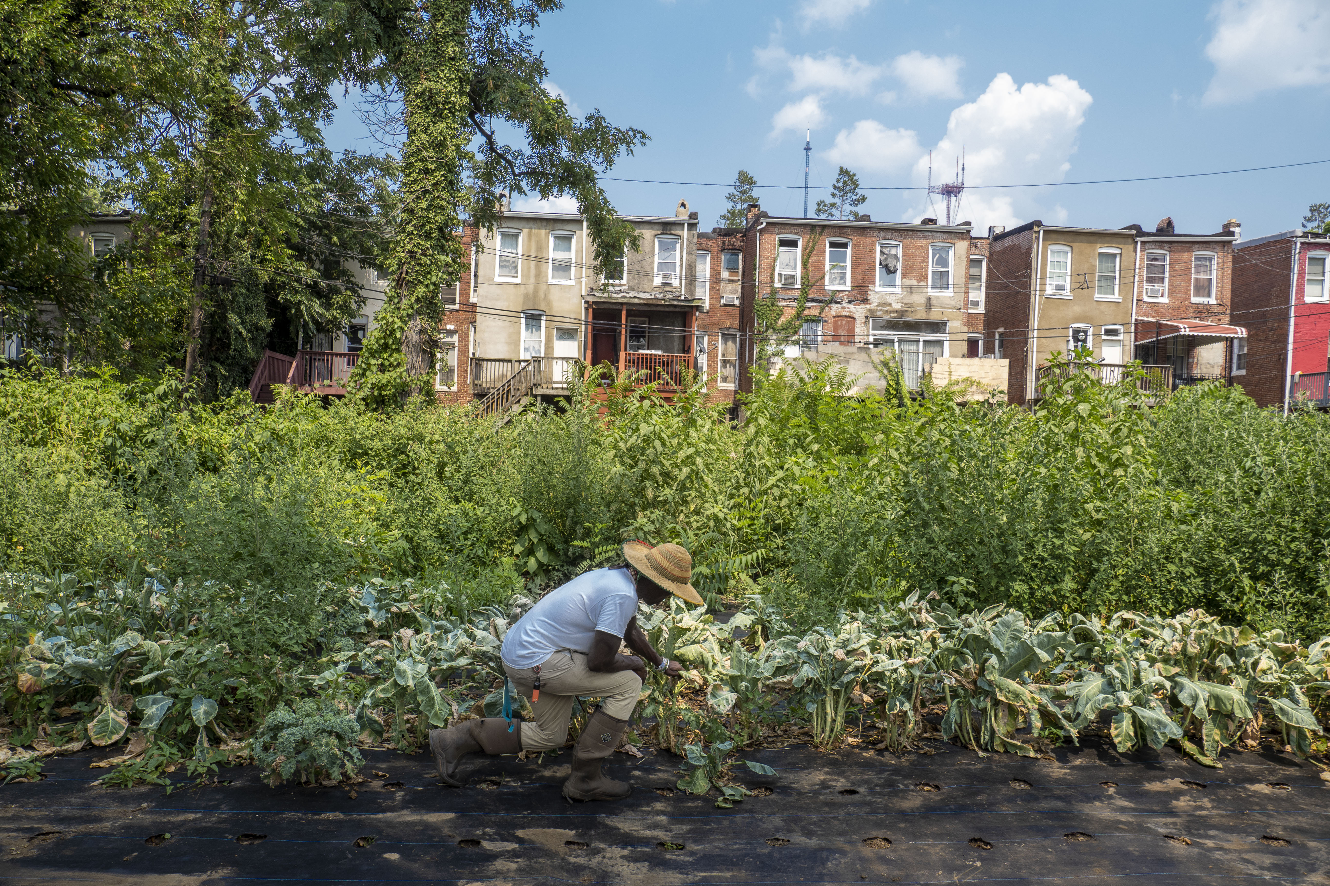
Urban Agriculture and Innovative Production Grants
Funded 31 competitive grants worth $7.77 million in 2020 and 2021 combined
Notes:
The program has funded 31 competitive grants worth $7.77 million in 2020 and 2021 combined. We have received over 500 applications for these grants so we are hopeful that Congress will see the great need and expand the amount of money allocated to this program.
Examples of Accomplishments
UAIP-PP
West Sacramento, CA.: Implemented collection/mapping of public health data points in underserved communities (e.g., % adults living with diabetes, % of overweight adults/teens/children, access to grocery stores/farmers’ markets, housing cost differentiation, adults living in poverty, SNAP enrollment, etc.)
UAIP-IP
Parkside Community Partnership (Camden, NJ): Established an urban ag collaborative (12 organizations, 9 gardens) supporting development of a hoop-house network and training program
UAIP-PP and CCFWR Dual Awardee
City of New Haven, CT.: Established a Community Advisory Board (agriculture, health, youth members) called New Haven Community Composting Collaborative to advance community composting and expand efforts on growing fresh food; diverted >160 tons of food waste over two years; projected to yield an estimated 170 cubic yards (cu yd) of compost. With the UAIP-PP they are developing the New Haven urban Agriculture Master Plan blueprint (guidelines and toolkits).
(NEXT SLIDE)

Slide 18
Other Responsibilities
Advising the Secretary…
Managing programs for community gardens…
Coordinating with agencies and officials of the USDA…
Engaging stakeholders and developing partnerships…
Facilitating community garden and local food bank ties…
Collaborating with other Federal agencies…
Notes:
By statute we also have other responsibilities:
Managing programs, including for community gardens, urban farms, rooftop agriculture, and indoor vertical production (one of the way we do that is through the People’s Garden Initiative)
Advising the Secretary (one of the ways we do that is through the federal advisory committee)
Coordinating with agencies and offices to update relevant programs
Engage stakeholders and developing external partnerships
Identifying common state and municipal best practices for navigating local permitting and zoning policies
Coordinating networks of community gardens and facilitating connections to local food banks w/ FNS
Collaborating with other Federal agencies (Department of Housing and Urban Development (HUD), Environmental Protection Agency (EPA), SBA)
(NEXT SLIDE)

Slide 19
USDA Internal Advisory Committee (IAC)
In February 2020 then FPAC Undersecretary Bill Northey established the IAC to:
ensure collaboration across the Department
develop recommendations on policy for USDA leadership
provide guidance to the Designated Federal Official for the Federal Advisory Committee
Notes:
In February of 2020 then FPAC Undersecretary Bill Northey established the IAC to
Ensure collaboration across the Department
Provide guidance the Designated Federal Official
Develop recommendations on policy for USDA Leadership
To ensure the committee's success, mission areas and agencies have appointed committee members with the skills to engage technical, subject matter, and policy expertise in the area of urban agriculture. This collaboration has highlighted USDA's commitment to fulfilling the mission of the Office.
The IAC has been meeting since that time and currently has 65 member representing 20 Office and Agencies.
The Office will have it first permanent Director starting on Monday and will create outreach plan to provide specific details on resources and commitments of the individual agencies to carry out collaborative efforts supporting urban and innovative agriculture. Additionally, the OUAIP Committee will 1) evaluate and review ongoing research and extension activities relating to urban, indoor, and other innovative agricultural practices, 2) identify new and existing barriers to successful urban, indoor, and other emerging agricultural production practices 3) develop recommendations on priorities and mechanisms for achieving statutory requirements.
The vison is for the Office and the IAC is to create a permanent home for Urban and Innovative Agriculture within the USDA.
That is a quick overview of why the Office came to be and what we have the authority to do. At this time Tammy Willis will discuss more of the with the Federal Advisory Committee.
Tammy I will turn the floor over to you
(NEXT SLIDE)

Slide 20
UAIP Advisory Committee Overview
Tammy Willis, UAIP Advisory Committee Coordinator

Slide 21
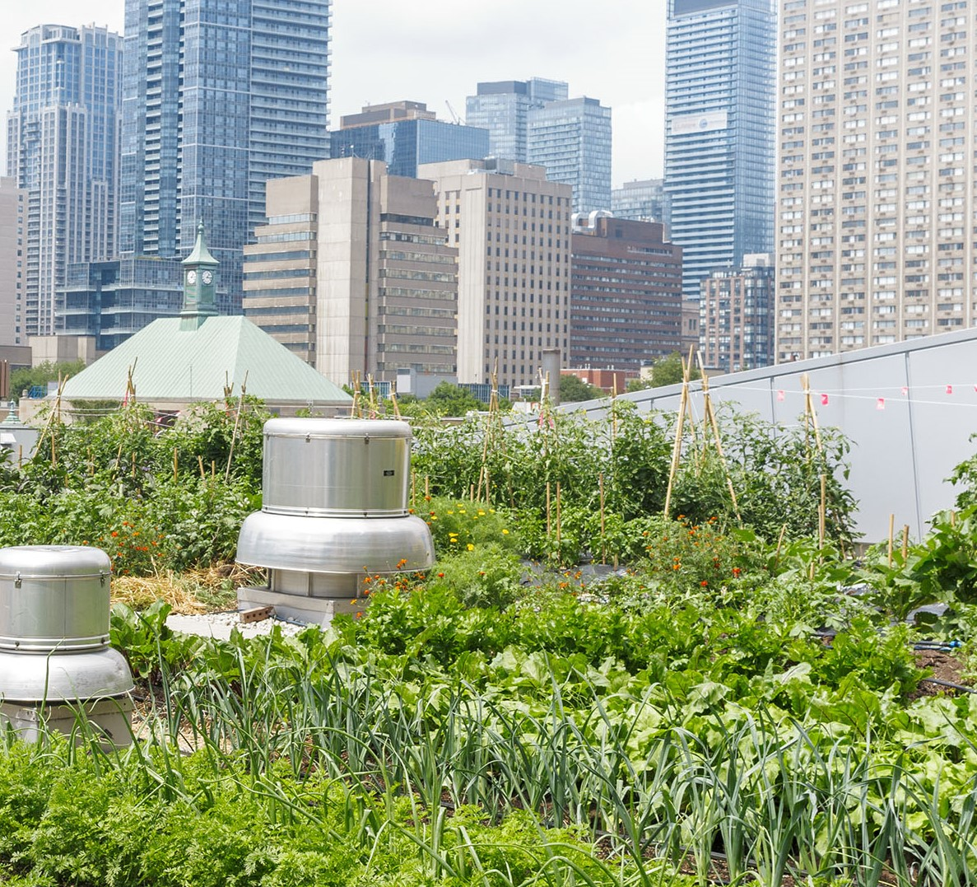
The Agriculture Improvement Act of 2018
also known as the 2018 Farm Bill
The 2018 Farm Bill opened the door for USDA to deepen its commitment to be a Department for the People. Through the Farm Bill, USDA will help the people in urban and suburban communities to improve their relationship with food and the environment.
Notes:
Through this process the Urban Agriculture and Innovative Production Advisory Committee was developed.

Slide 22
Urban Agriculture and Innovative Production Advisory Committee (UAIPAC)
12 Members:
2 individuals who are urban agricultural producers
2 individuals who are innovative producers
2 representatives from an institution of higher education
1 individual who represents a nonprofit organization
1 individual who represents business and economic development
1 individual with supply chain experience
1 individual from a financing entity
2 individuals with related experience or expertise in urban, emerging agriculture production practices
Notes:
The Committee is composted of 12 MEMBERS
4 individuals who are agricultural producers
2 representatives from an institution of higher education or extension program
1 individual who represents a nonprofit organization
1 individual who represents business and economic development
1 individual with supply chain experience
1 individual from a financing entity
2 individuals with related experience or expertise in urban, emerging agriculture production practices as determined by the Secretary.

Slide 23
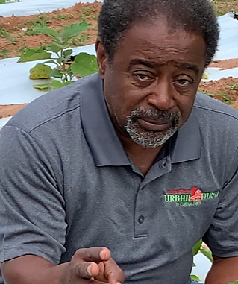
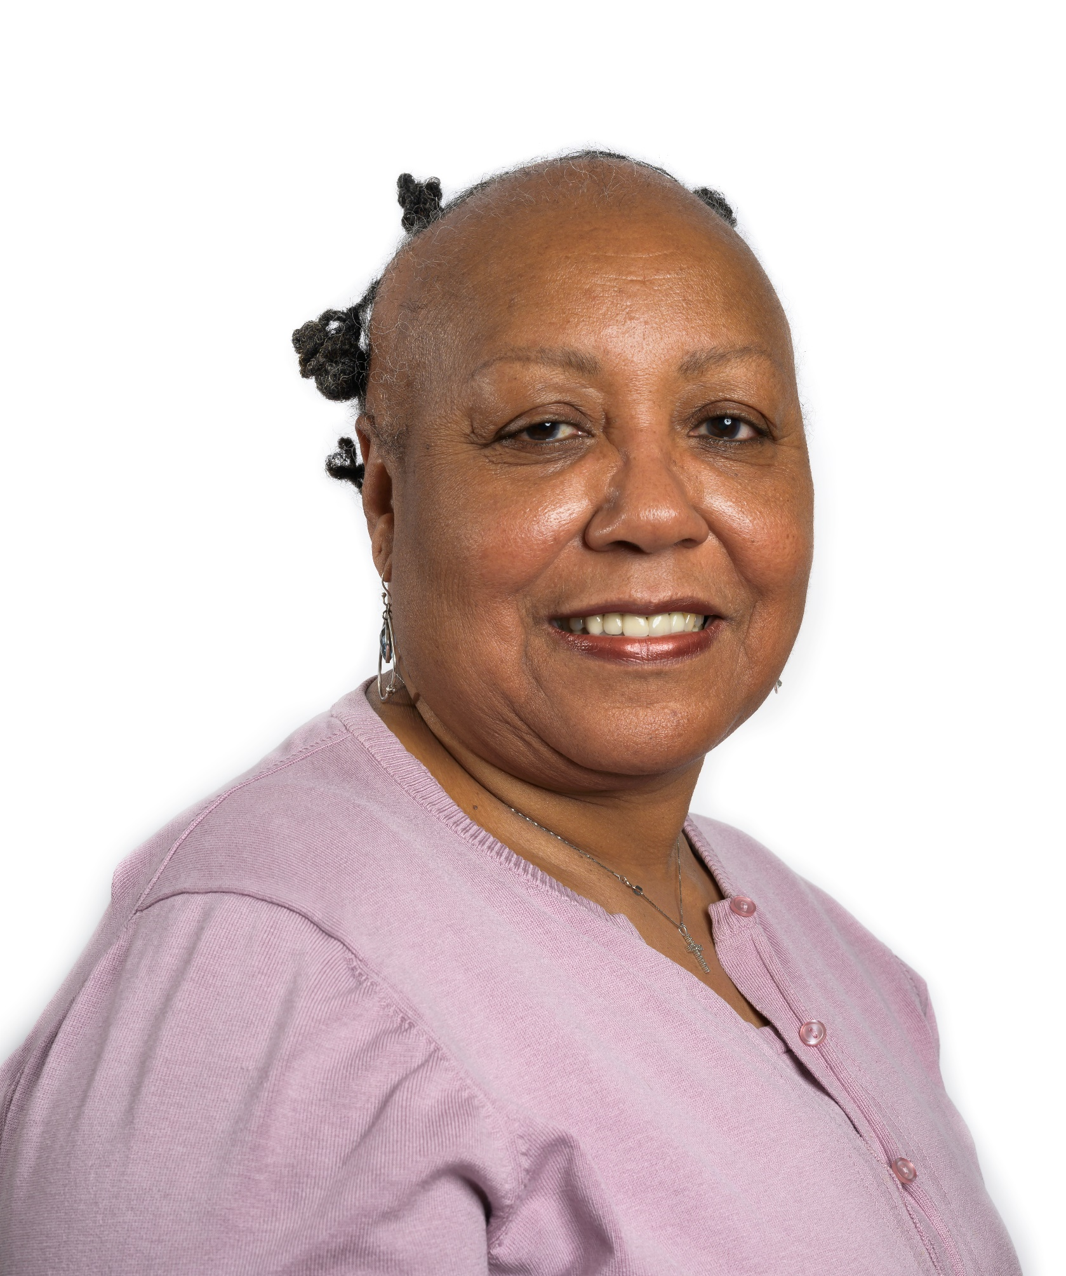
2 individuals who are urban agricultural producers
Bobby Wilson
Owner and Operator
Metro Atlanta Urban Farm
Jerry Ann Hebron
Executive Director
Northend Christian

Slide 24
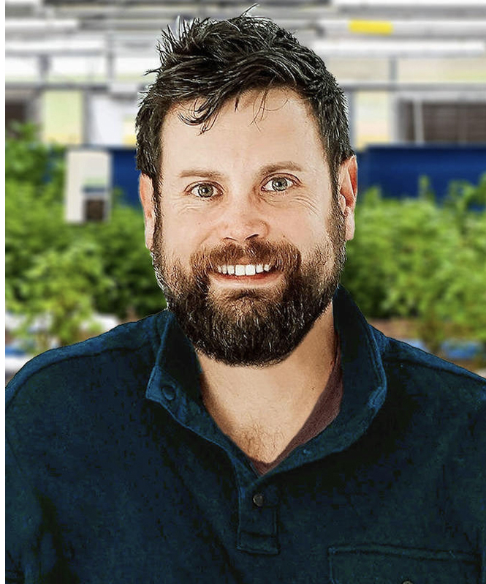
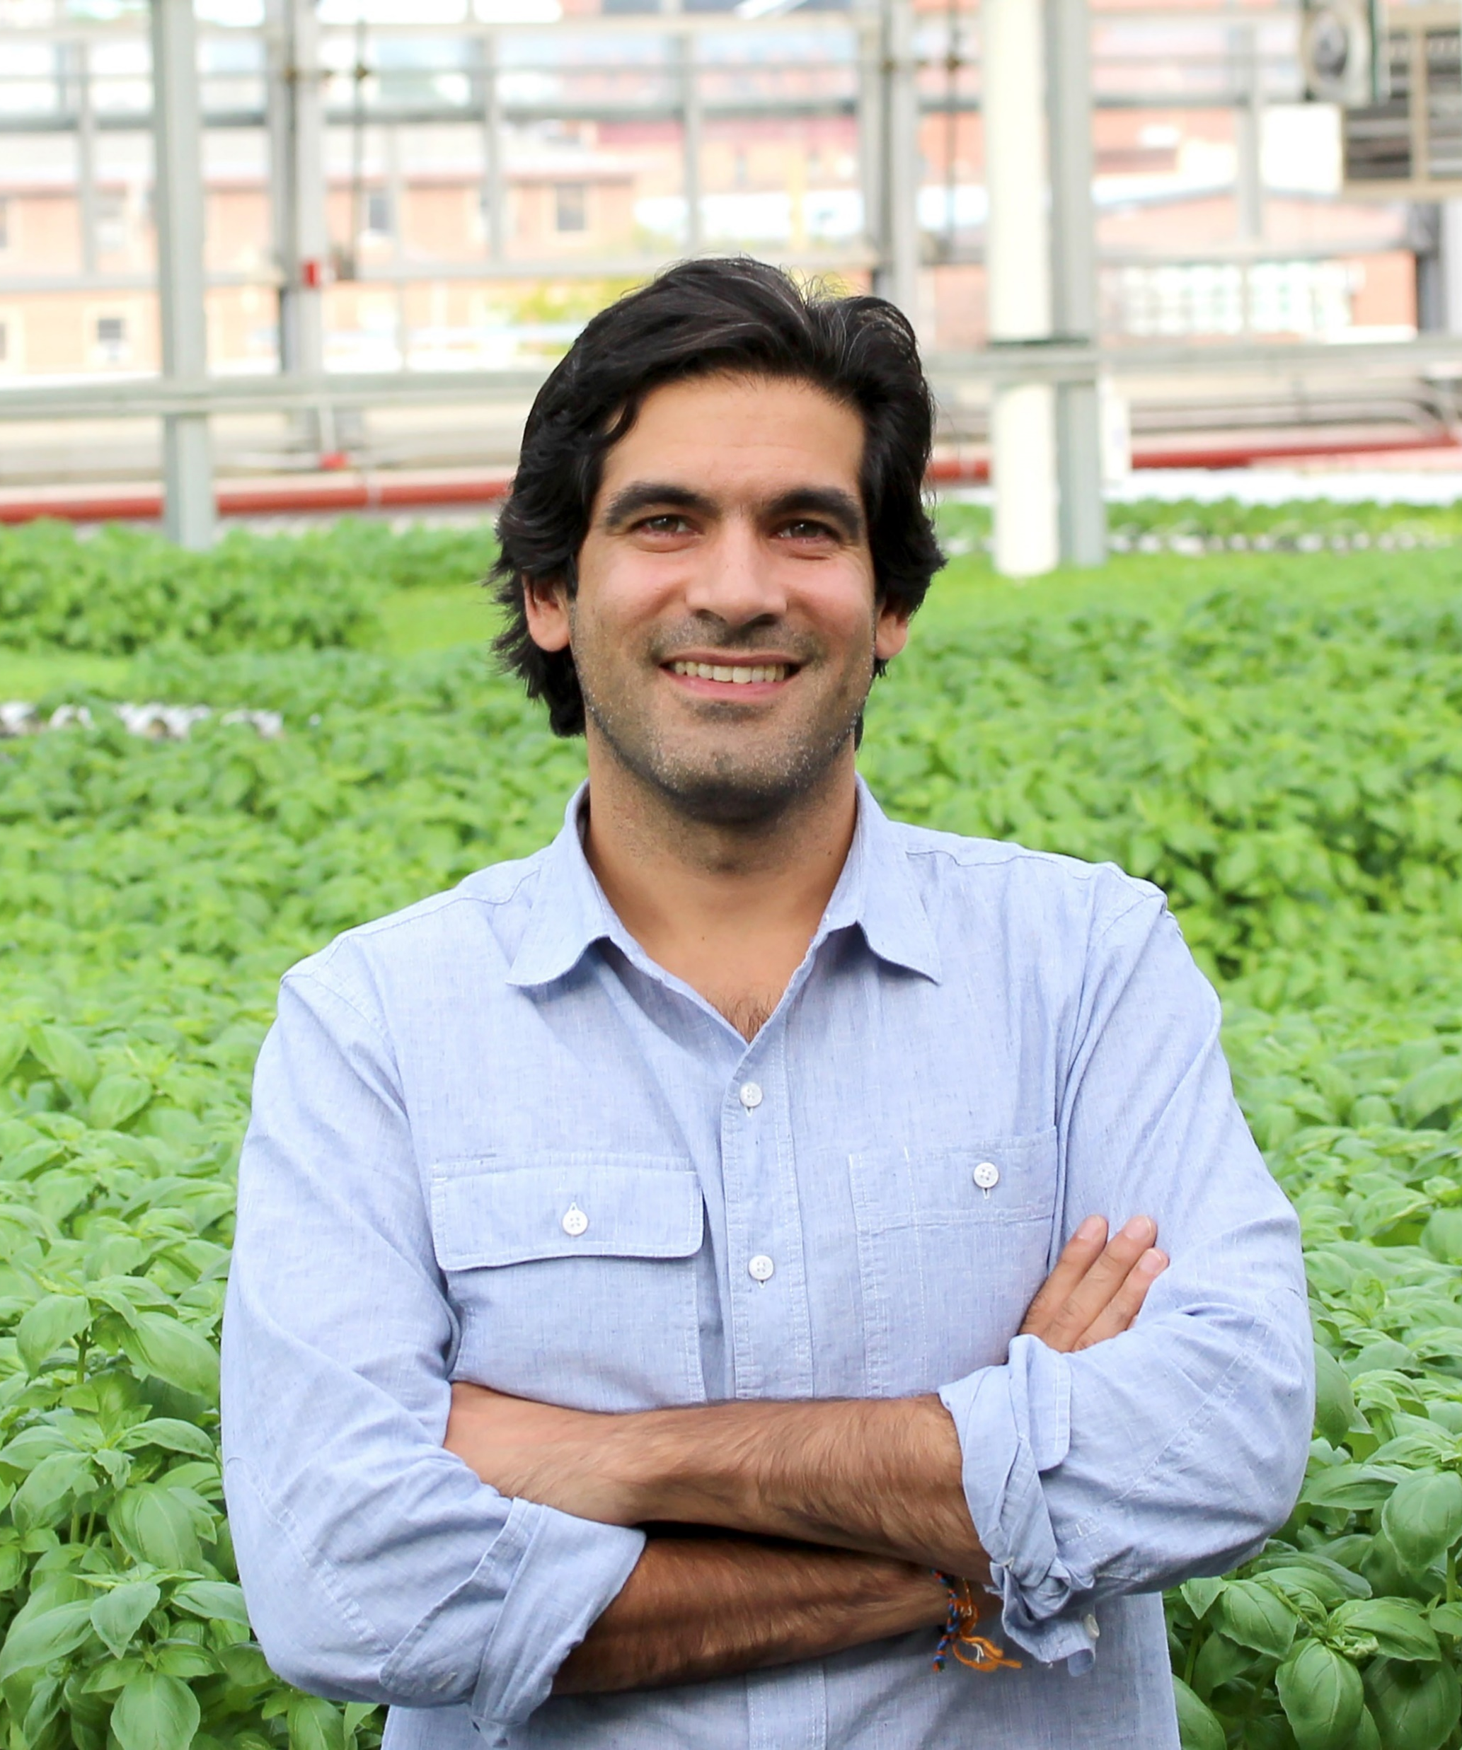
2 individuals who are innovative producers
Kaben Smallwood
President and CEO
Symbiotic Aquaponic
Viraj Puri
CEO and Co-Founder
Gotham Greens

Slide 25
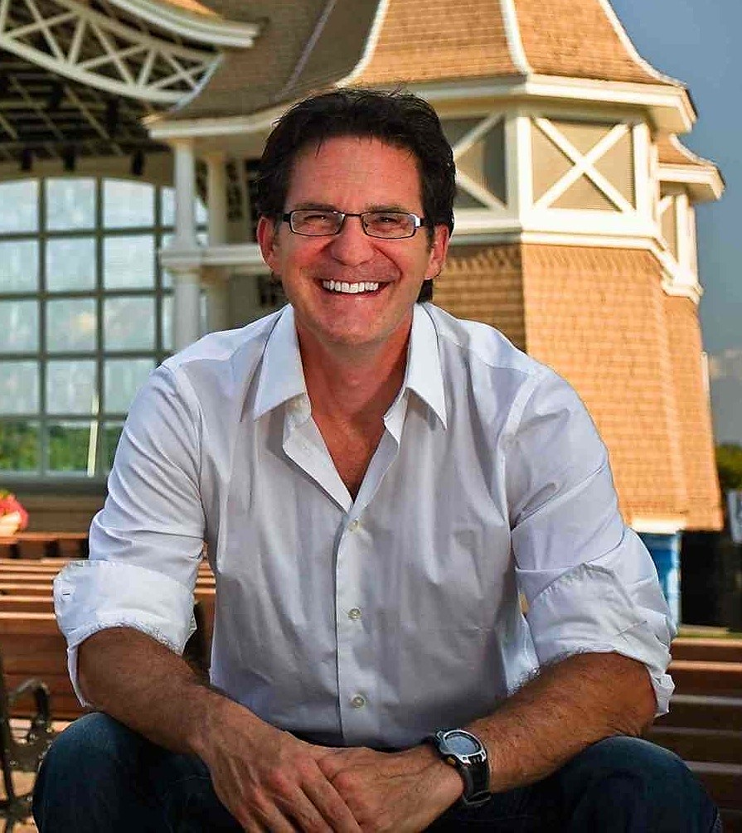
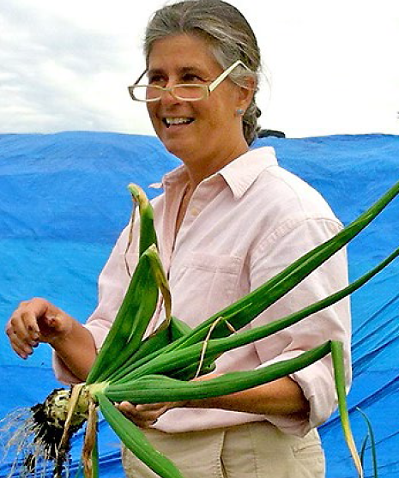
2 representatives from an institution of higher education
John Erwin
Professor and Chair
University of Maryland
Sally Brown
Research Professor
University of Washington

Slide 26
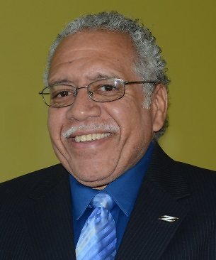
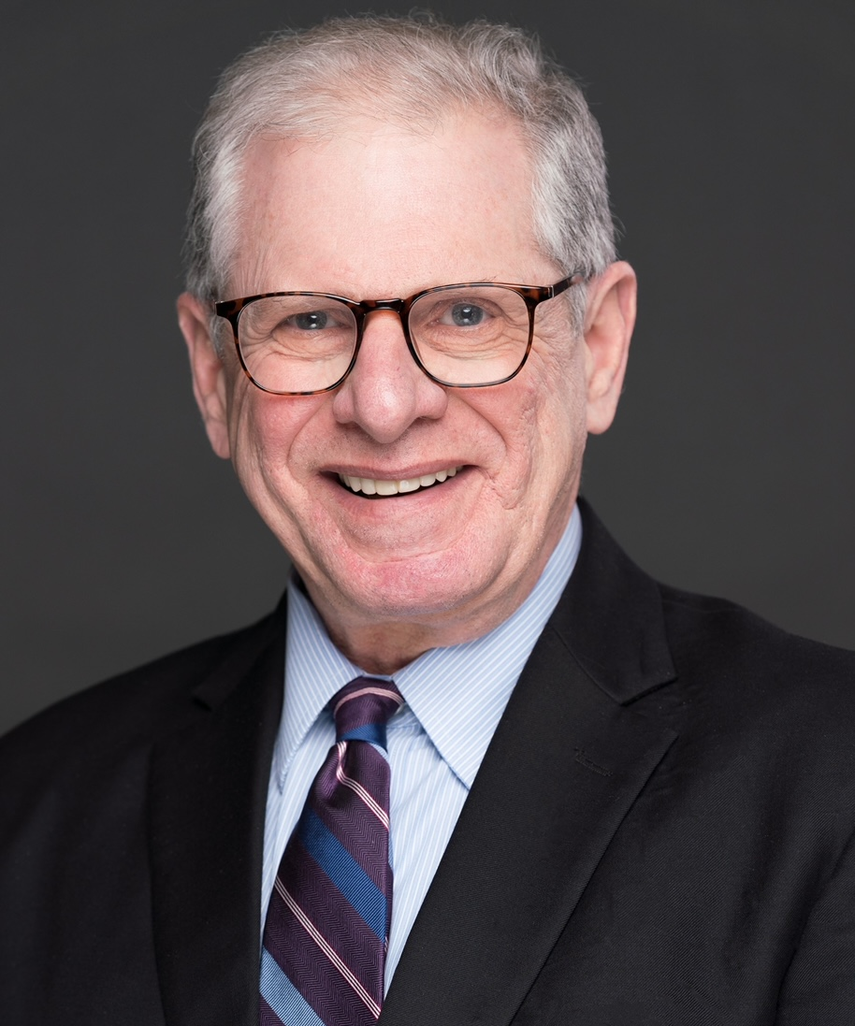
1 individual who represents a nonprofit organization
Dr. Carl Wallace
Chief Operating Officer
Abundant Life Farm
1 individual who represents business and economic
development
John Lebeaux
Commissioner
Massachusetts Department of Agricultural Resources (MDAR)

Slide 27
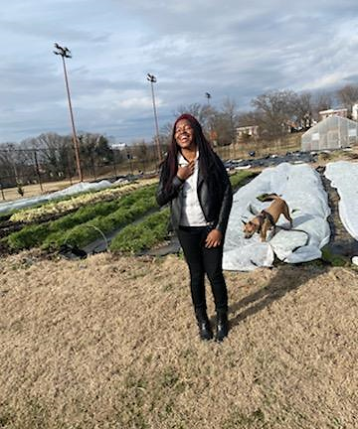
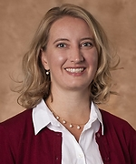
1 individual with supply chain experience
Zachari Curtis
Operations Director
Dreaming Out Loud, Inc.
1 individual from a financing entity
Allison Paap
Vice President-Lending Manger
American AgCredit

Slide 28
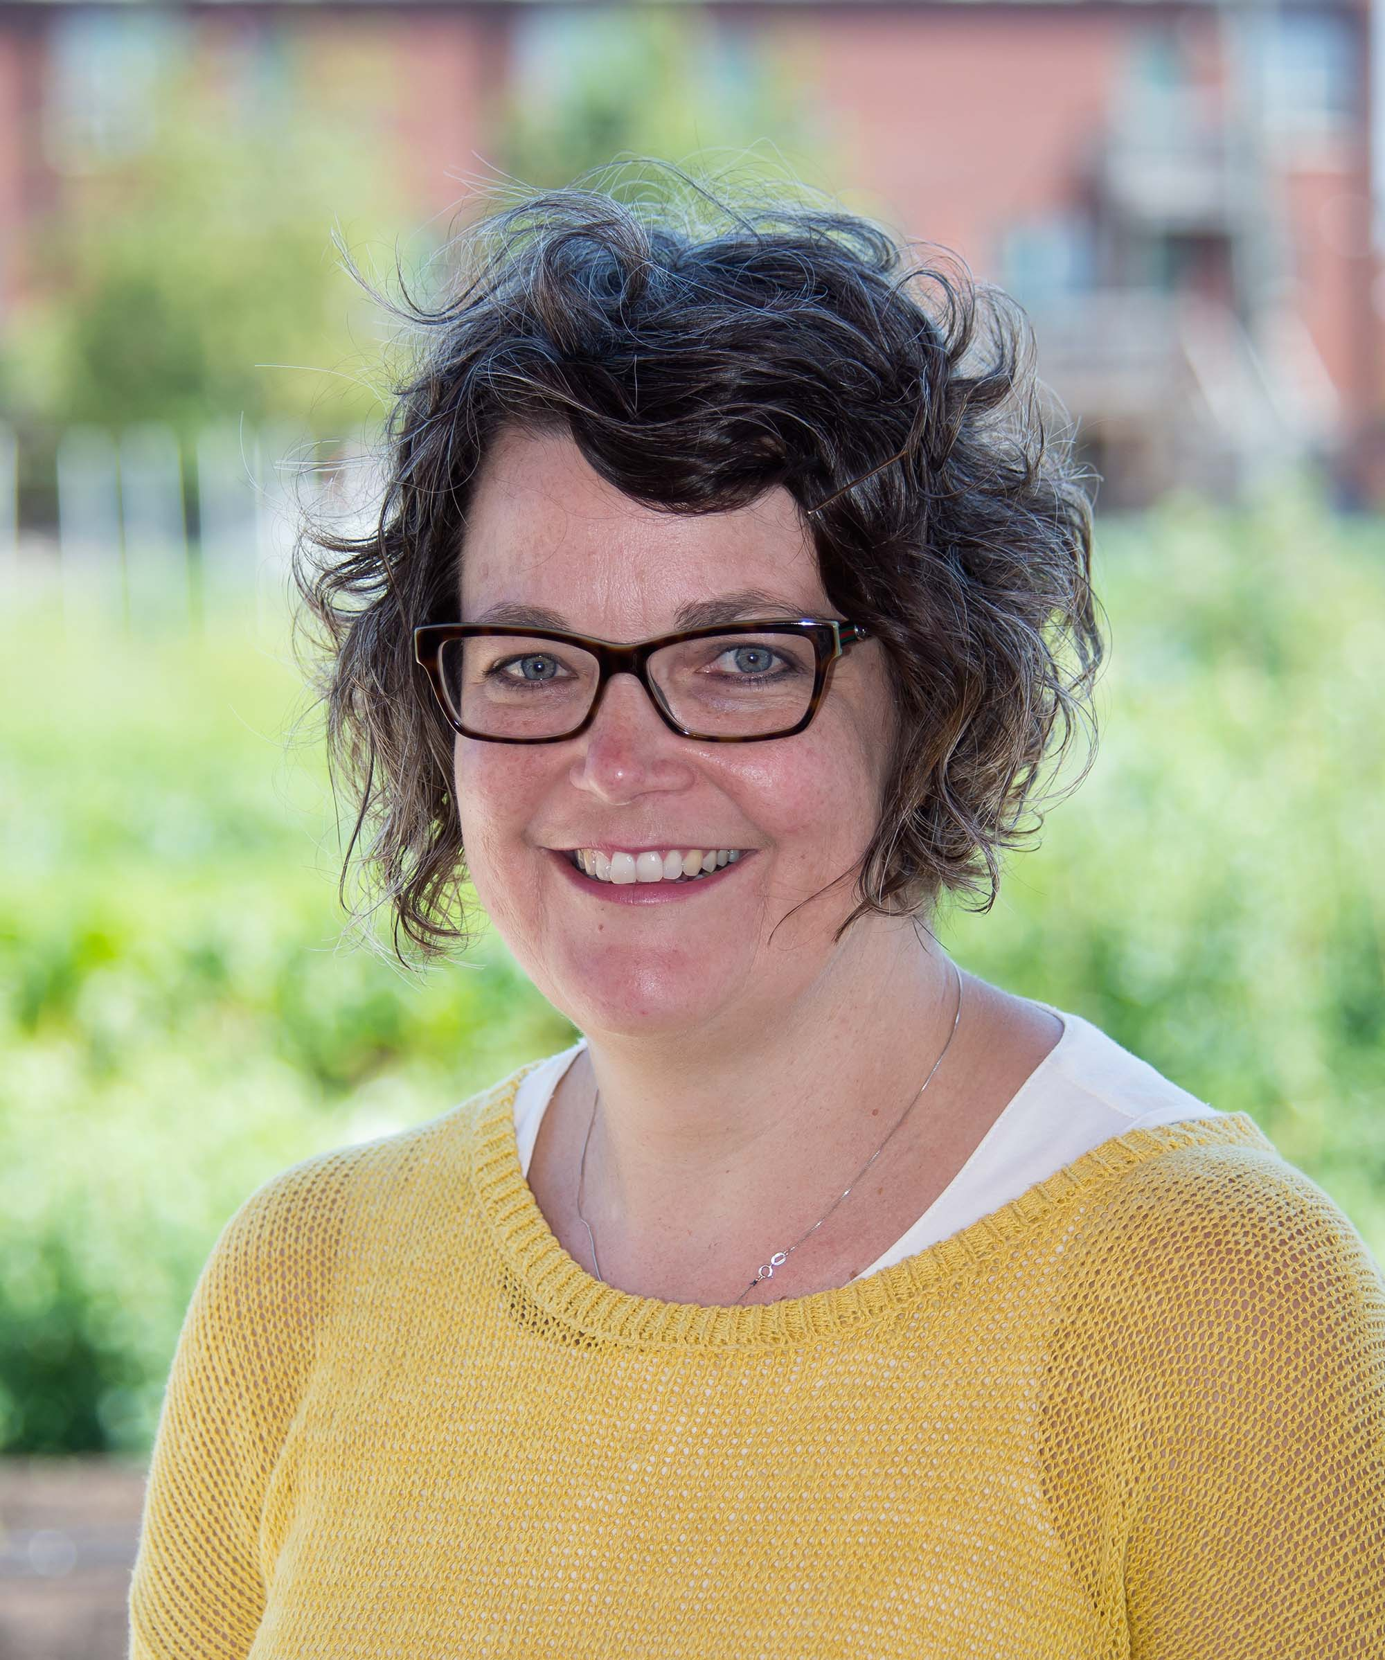
2 individuals with related experience or expertise in urban, emerging agriculture production practices
Angela Mason
Senior Director
Shangri La Botanical Garden and Nature Center
Tara Chadwick
Urban Farmer/Producer
Home Beautiful Park Civic Association

Slide 29
Urban Agriculture and Innovative Production Advisory Committee (UAIPAC)
The Committee Initial Appointments:
4 of the members have been appointed to a term of 3 years;
4 of the members have been be appointed for a term of 2 years; and
4 of the members have been appointed for a term of 1 year.
Vacancies on the Committee will be posted on https://www.farmers.gov/urban
Vacancies will be filled as soon as practicable in the same manner as the original appointment.
Notes:
The Committee Initial Appointments:
4 of the members have been appointed to a term of 3 years;
4 of the members have been be appointed for a term of 2 years; and
4 of the members have been appointed for a term of 1 year.
Vacancies on the Committee will be posted on https://www.farmers.gov/urban
Vacancies will be filled as soon as practicable in the same manner as the original appointment.

Slide 30
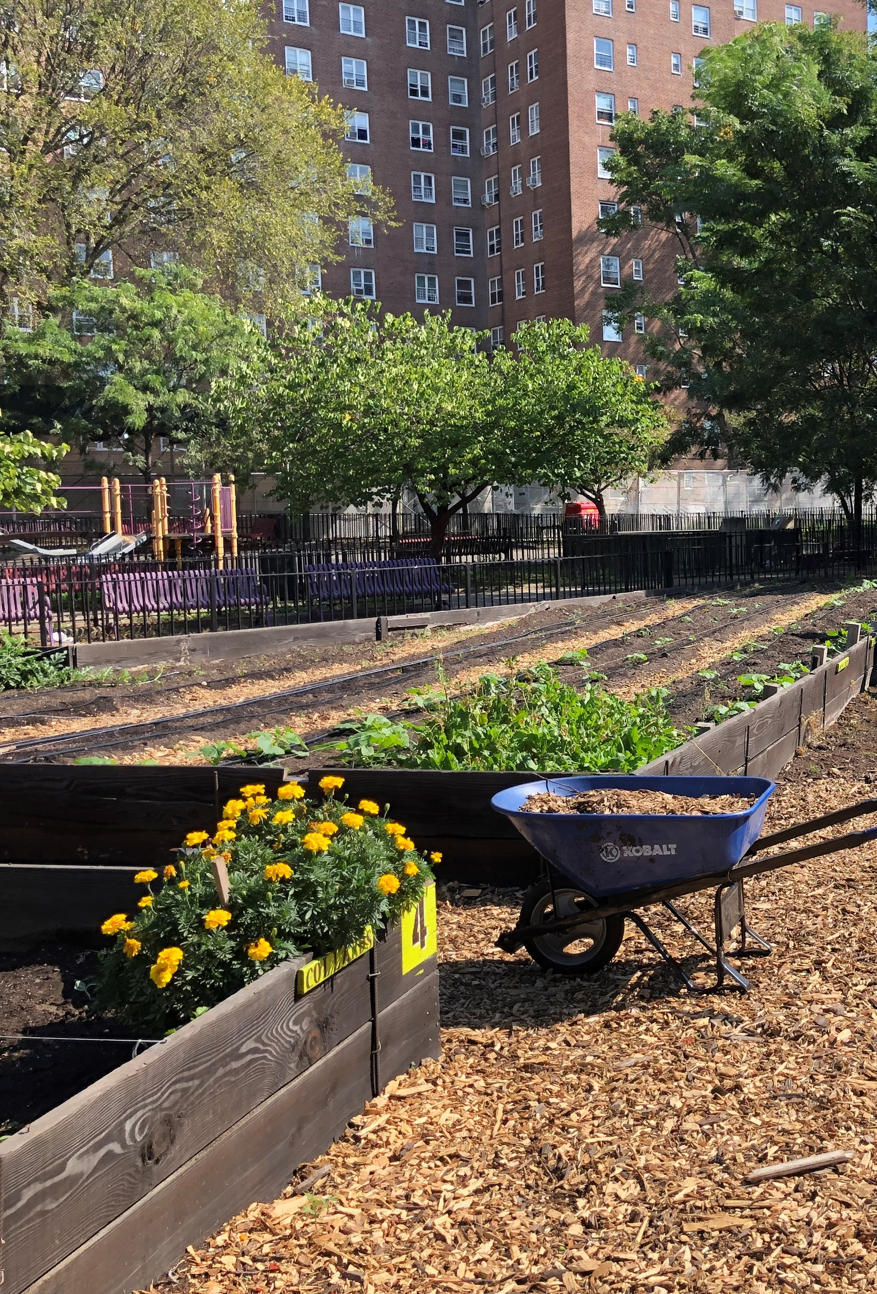
Urban Agriculture and Innovative Production Advisory Committee (UAIPAC)
Committee Duties:
Develop recommendations and advise the Director
Evaluate and review ongoing research
Identify new and existing barriers
Provide additional assistance to the Director as appropriate.
Notes:
The Advisory Committee will assist with the encouragement and promoting urban, indoor, and other emerging agricultural practices. Let's talk about the committee duties,
They are but not limited too:
To develop recommendations and advise the Director on policies, initiatives, and outreach administered by the Office of Urban Agriculture and Innovative.
Evaluate and review ongoing research and extension activities relating to urban, indoor, and other innovative agricultural practice.
Identify new and existing barriers to successful urban, indoor, and other emerging agricultural production practices.
Provide additional assistance and advice to the Director as appropriate.

Slide 31
Designated Federal Official (DFO) Role and Responsibilities
Ensure compliance with the Federal Advisory Committee Act Data Base (FACA-DB)
Call, attend, and adjourn committee meetings;
Approve agendas;
Maintain required records on costs and membership;
Maintain records for availability to the public; and
Provide copies of committee reports to the Committee Management Officer.
Notes:
The Director of the Urban Agriculture and Innovative Production Office also serves as the Designated Federal Officers to the Advisory Committee.
The duties of the Designated Federal Officers are but not limited to:
Ensure compliance with the Federal Advisory Committee Act (FACA), and any other applicable laws and regulations;
Call, attend, and adjourn committee meetings
Approve agendas;
Maintain required records on costs and membership;
Ensure efficient operations;
Maintain records for availability to the public; and
Provide copies of committee reports to the Committee Management Officer for forwarding to the Library of Congress.

Slide 32
UAIPAC Chair, Role and Responsibilities
Leadership: understand FACA requirements, ethics, bylaws, key issues, etc.
Knows the agenda and agency-needs more than any other member
Help identify fact-finding needs
Problems with members
Certify minutes within 90 calendar days
Notes:
The Committee Chair, Role and Responsibilities
Leadership: understand FACA requirements, ethics, bylaws, KEY ISSUES, etc.
Knows the agenda and agency-needs more than any other member
Help identify fact-finding needs
Documents the committee’s advice
Promotes contribution
Problems with members
Certify minutes within 90 calendar days

Slide 33
UAIPAC Vice Chair, Role and Responsibilities
Chair Committee meetings when the Chairperson is unavailable
Serve as a member of the Committee
Serve as a member of subcommittee(s)
Help maintain the Committee Operating Procedure Guide
Notes:
UAIPAC Committee Vice Chair, Role and Responsibilities
Chair Committee meetings when the Chairperson is unavailable
Serve as a member of the Committee
Serve as a member of subcommittee(s)
Help maintain the Committee Operating Procedure Guide
For more information about the Committee please visit the www.farmers.gov/urban
At this time, I would like to introduce,
Havala Schumacher, with the OUAIP and Suzanne Pender, with Farm Production and Conservation Office
Urban Agriculture Toolkit and UAIPAC Feedback

Slide 34
Urban Agriculture Toolkit and UAIPAC Feedback
Havala Schumacher, OUAIP
Suzanne Pender, Farm Production and Conservation

Slide 35
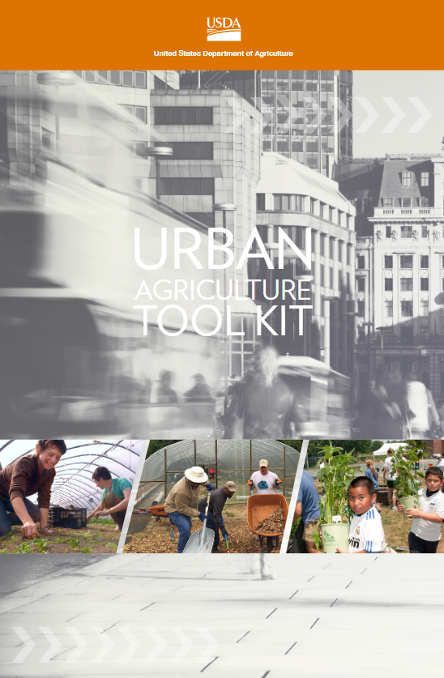
Toolkit: Prior Approach
USDA Urban Ag Toolkit 1.0:
18-page PDF
Large number of external links:
Challenging to validate non-USDA links
Resource was often printed, limiting the use of links
Notes:
Havala (add talking points)

Slide 36
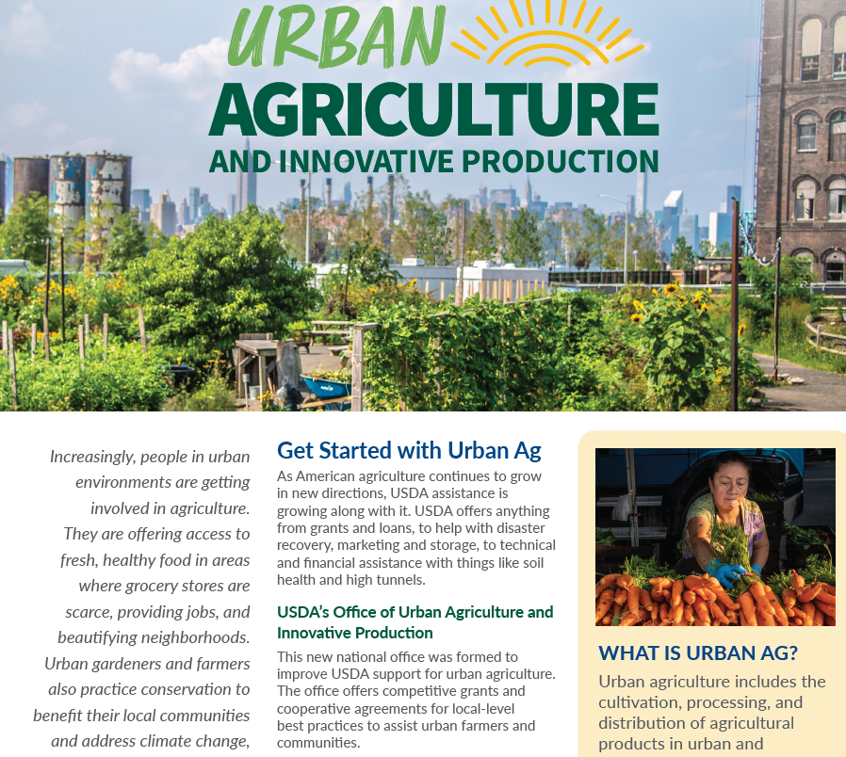
Toolkit 2.0
Quick-reference guides:
Get Started (new)
UAIP Grants (new)
Federal Advisory Committee (new)
Composting and Food Waste Reduction (existing)
Urban Agriculture At-a-Glance
6-7 pages
Focus on key USDA resources available to urban producers and to others who want to support urban food systems
Notes:
Suzanne
NRCS has an Urban Ag quick reference guide and website
FSA is considering developing one.
Agency specific pages should link to specific resources.
Pages should make clear that there is a broader USDA effort.

Slide 37
Toolkit 2.0
Website updates:
Enhancements to Farmers.gov/urban to focus specifically on urban producers
Develop new USDA.gov/urban website focusing on non-producer urban agriculture resources and USDA organizational information
Notes:
Suzanne
NRCS has an Urban Ag quick reference guide and website
FSA is considering developing one.
Agency specific pages should link to specific resources.
Pages should make clear that there is a broader USDA effort.

Slide 38
Approach Taken
Compile and re-organize resources gathered through:
Input provided by USDA counterparts
Existing toolkit and other USDA resources
Organize these resources:
What can they be used for?
Who are they most useful to?
Where should information about them be accessed?
Notes:
Havala

Slide 39
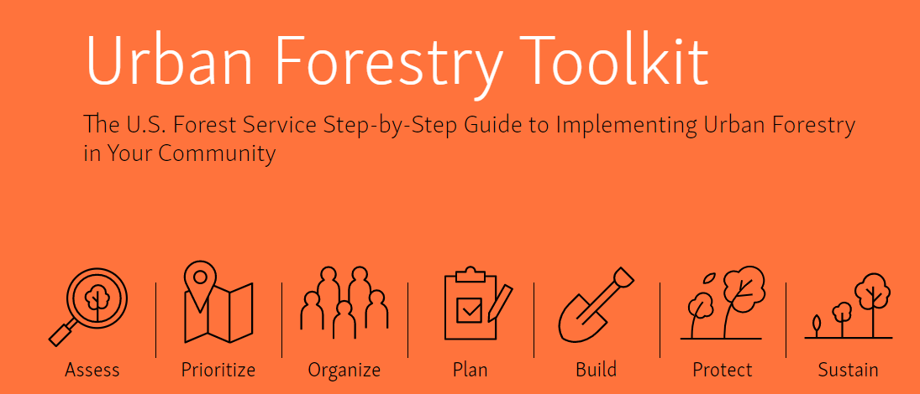
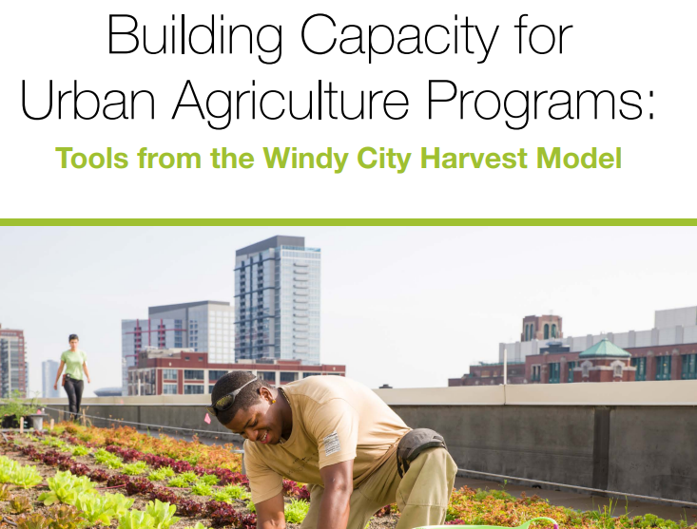
Approach Taken
Avoid duplication of other Toolkits:
US Forest Service Urban Forestry Toolkit
US Botanical Gardens Urban Agriculture Toolkit
Sustainable Agriculture Research and Education (SARE) How-To Guide
Focus FIRST on what USDA can provide our urban customers
Notes:
Havala

Slide 40
We Asked…
Is this resource directly relevant to urban producers?
Do the webpages for these resources clearly communicate to target audiences?
What are our customers looking for when they visit one of our offices or websites? Are there barriers to entry that we can address in our communications?
Notes:
Havala

Slide 41
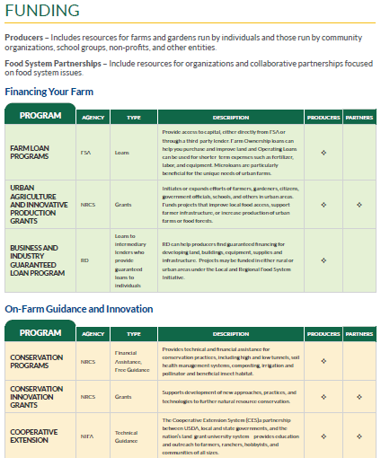
Urban Ag At-A-Glance
Details about programs to help with financing, marketing, selling, and getting technical assistance.
Description, type of program, and who it is most relevant to.
Separate section for operations at the rural-urban interface
Notes:
Suzanne

Slide 42
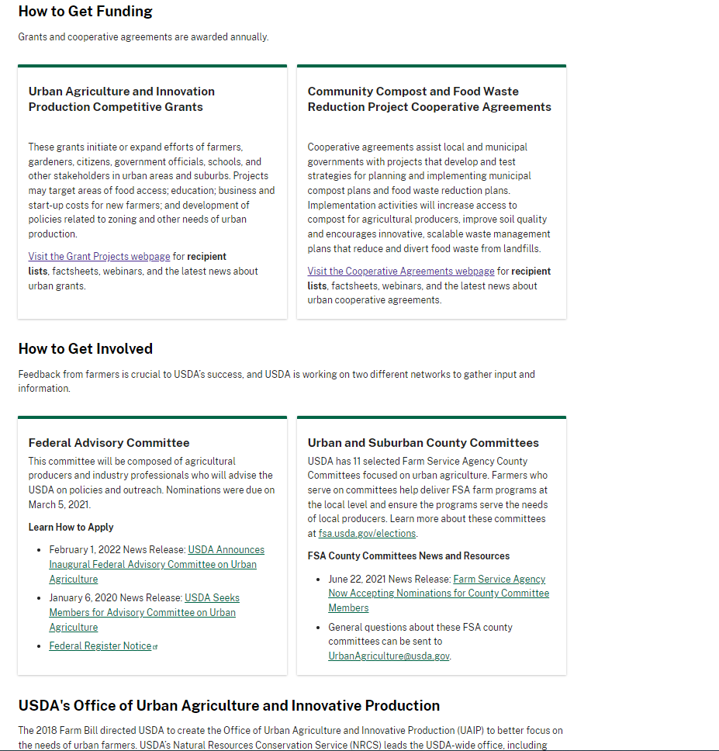
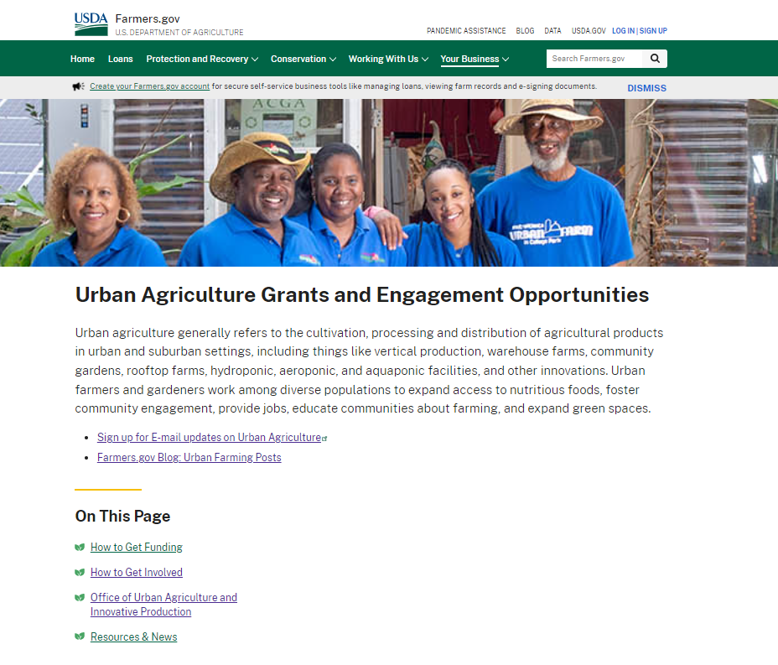
Current Farmers.gov/Urban page
Notes:
Suzanne

Slide 43
Planned Website Update: Farmers.gov/urban
Producer-focused
Will include specific sections for:
Starting, financing, and protecting a farm
Acquiring guidance and technical assistance
Marketing or selling products.
Resources for specific groups (community groups, schools, and others)
Notes:
Suzanne

Slide 44
Website Update: USDA.gov/urban
Public - focused
Will Include:
Training/guidance for groups and communities
Resources for strengthening local and regional food systems
Programs (like WIC) designed to directly improve access to healthy foods
Notes:
Suzanne

Slide 45
Tell Us!
What information does your community need most from USDA?
How can we better inform urban producers about our assistance?
What other kinds of tools should we add to our Toolkit?
What has been your experience when asking USDA about Urban Ag resources? Are there barriers to entry that we can address?
We’ve taken recent steps to update our websites. Let us know – how can we be even more accessible, clear, and easy to understand?
Notes:
Havala
Examples: “So you’re involved in vertical farming…”
Grant-writing guide for agricultural nonprofits
Research opportunities in Urban Agriculture
Etc.

Slide 46
OUAIP Contact Information
Leslie Glover, Program Manager, leslie.glover@usda.gov
Tammy Willis, UAIP Advisory Committee Coordinator, tammy.willis@usda.gov
Havala Schumacher, Management Analyst, havala.schumacher@usda.gov
Suzanne Pender, Strategic Communications, suzanne.pender@usda.gov
General OUAIP Staff Email Box: UrbanAgriculture@usda.gov
Notes:
Havala
Examples: “So you’re involved in vertical farming…”
Grant-writing guide for agricultural nonprofits
Research opportunities in Urban Agriculture
Etc.

Slide 47
Urban, Indoor, and Emerging Agriculture Grant
Bradley Rein, National Science Liaison
National Institute of Food and Agriculture

Slide 48
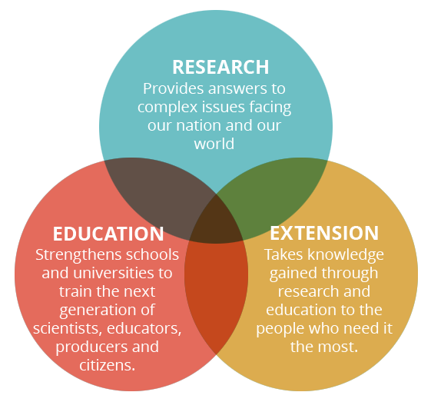
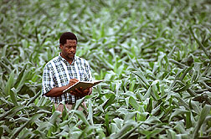

Slide 49
Pub. L. 101–624, title XVI, §1672E. URBAN, INDOOR, AND OTHER EMERGING AGRICULTURAL PRODUCTION RESEARCH, EDUCATION, AND EXTENSION INITIATIVE.
(a) COMPETITIVE RESEARCH AND EXTENSION GRANTS AUTHORIZED:
In consultation with the Urban Agriculture and Innovative Production Advisory Committee established under section 222(b) of the Department of Agriculture Reorganization Act of 1994
Secretary may make competitive grants to support research, education, and extension activities for the purposes of facilitating the development of urban, indoor, and other emerging agricultural
production, harvesting, transportation, aggregation, packaging, distribution, and markets
including by – (next slide)

Slide 50
‘‘(1) assessing and developing strategies to remediate contaminated sites;
‘‘(2) determining and developing the best production management and integrated pest management practices;
‘‘(3) identifying and promoting the horticultural, social, and economic factors that contribute to successful urban, indoor, and other emerging agricultural production;
‘‘(4) analyzing the means by which new agricultural sites are determined, including an evaluation of soil quality, condition of a building, or local community needs;
‘‘(5) exploring new technologies that minimize energy, lighting systems, water, and other inputs for increased food production;
‘‘(6) examining building material efficiencies and structural upgrades for the purpose of optimizing growth of agricultural products;
‘‘(7) developing new crop varieties and agricultural products to connect to new markets; or
‘‘(8) examining the impacts of crop exposure to urban elements on environmental quality and food safety.

Slide 51
Preparation for Advisory Committee Consultation
Solicit stakeholder input on most critical and urgent research education and extension needs to support urban, indoor, and emerging agriculture through Federal Register Notice and four Listening Sessions
Analyze results of stakeholder input of most critical and urgent needs
Prepare draft request for applications based on stakeholder input and SEC. 172E. authorization guidelines

Slide 52
UIE Federal Register Notice FR Doc 2020-08402
Developed NIFA webpage with information on the new urban agriculture initiative, link to the Federal Register Notice (FRN), and links to related NIFA and USDA programs
Published FRN 04/21/2020 with written comments due by 06/22/2020
Stakeholders were given the authorizing language Pub. L. 101–624, title XVI, §1672E(a). They were asked to prioritize the food system stages (production through marketing) and which of the 8 priority areas listed in the authorization have the most urgent unmet needs that could be addressed through research, extension and/or education.

Slide 53
Question # 1 Considering agricultural production through marketing; which phase has the greatest and most urgent research, education and Extension needs in developing urban and indoor agriculture?
(a) Agricultural Production
(b) Harvesting
(c) Transportation
(d) Aggregation
(e) Packaging
(f) Distribution
(g) Markets

Slide 54
Question #2: Of the eight priorities listed below, which priority has the greatest and most urgent REE need in developing urban and indoor agriculture that is not being adequately addressed in other Federal REE programs?
(1) assessing and developing strategies to remediate contaminated sites;
(2) determining and developing the best production management and integrated pest management practices;
(3) identifying and promoting the horticultural, social, and economic factors that contribute to successful urban, indoor, and other emerging agricultural production;
(4) analyzing the means by which new agricultural sites are determined, including an evaluation of soil quality, condition of a building, or local community needs;
(5) exploring new technologies that minimize energy, lighting systems, water, and other inputs for increased food production;
(6) examining building material efficiencies and structural upgrades for the purpose of optimizing growth of agricultural products;
(7) developing new crop varieties and agricultural products to connect to new markets; or
(8) examining the impacts of crop exposure to urban elements on environmental quality and food safety.

Slide 55
Question # 1 Considering agricultural production through marketing; which phase has the greatest and most urgent REE needs in developing urban and indoor agriculture?

Slide 56
Question #2: Of the eight priorities listed in the authorization, which priority has the greatest and most urgent REE need in developing urban and indoor agriculture that is not being adequately addressed in other Federal REE programs.
(3) identifying and promoting the horticultural, social, and economic factors that contribute to successful urban, indoor, and other emerging agricultural production
(4) analyzing the means by which new agricultural sites are determined, including an evaluation of soil quality, condition of a building, or local community needs
(7) developing new crop varieties and agricultural products to connect to new markets

Slide 57
Eligible Applicants in Authorization
Applications may only be submitted by the following entities:
State agricultural experiment stations;
colleges and universities;
university research foundations;
other research institutions and organizations;
Federal agencies;
national laboratories;
private organizations, foundations, or corporations;
individuals; or
any group consisting of 2 or more of the entities described in subparagraphs (A) through (H).

Slide 58
NIFA Competitive Funding Attributes
Integrity
Authorization compliant
Purpose and priorities
Quality
Peer review
3 reviews/application minimum
Applicant Support
Program fit guidance
Reviews and summaries
Fairness/screen conflicts of interest
Reviewer confidentiality
Peer rating and ranking
Applicant webinars
Evaluation process and criteria
Stakeholder input

Slide 59
Questions
&
Comments
Brad Rein PE
National Science Liaison
National Institute of Food and Agriculture
Email: brein@usda.gov

Slide 60
Meeting Adjourned
In accordance with Federal civil rights law and U.S. Department of Agriculture (USDA) civil rights regulations and policies, the USDA, its Agencies, offices, and employees, and institutions participating in or administering USDA programs are prohibited from discriminating based on race, color, national origin, religion, sex, gender identity (including gender expression), sexual orientation, disability, age, marital status, family/parental status, income derived from a public assistance program, political beliefs, or reprisal or retaliation for prior civil rights activity, in any program or activity conducted or funded by USDA (not all bases apply to all programs). Remedies and complaint filing deadlines vary by program or incident.
Persons with disabilities who require alternative means of communication for program information (e.g., Braille, large print, audiotape, American Sign Language, etc.) should contact the responsible Agency or USDA's TARGET Center at (202) 720-2600 (voice and TTY) or contact USDA through the Federal Relay Service at (800) 877-8339. Additionally, program information may be made available in languages other than English.
To file a program discrimination complaint, complete the USDA Program Discrimination Complaint Form, AD-3027, found online at How to File a Program Discrimination Complaint and at any USDA office or write a letter addressed to USDA and provide in the letter all of the information requested in the form. To request a copy of the complaint form, call (866) 632-9992. Submit your completed form or letter to USDA by: (1) mail: U.S. Department of Agriculture, Office of the Assistant Secretary for Civil Rights, 1400 Independence Avenue, SW, Washington, D.C. 20250-9410; (2) fax: (202) 690-7442; or (3) email: program.intake@usda.gov.
USDA is an equal opportunity provider, employer, and lender.
https://www.farmers.gov/urban
Notes:
Slide on

Slide 61
Urban County Committees and Service Centers
Jenna Segal, FSA
Arthur Hawkins, OUAIP
Notes:
Slide on

Slide 62
Urban/Suburban County Committees
Office of Urban Agriculture
Notes:
Hi Everyone: In addition to all of the great work that OUAIP has been leading across the agency, OUAIP has been supporting FSA in implementing a pilot project to establish Urban County Committees (UCOC’s) in no fewer than ten cities across the country. This was authorized by he Agriculture Improvement Act of 2018 (2018 Farm Bill), and FSA has been working closely with OUAIP to identify pilot locations and stand up these new committees. To date, we have created 11 Urban County Committees in the Following Locations:
· Albuquerque, NM
· Atlanta, GA
· Cleveland, OH
· Dallas, TX
· Minneapolis, MN
· New Orleans, LA
· Philadelphia, PA
· Phoenix, AZ
· Portland, OR
· Richmond, VA
· St. Louis, MO
The locations were selected based on a consideration of data that included levels of economic distress, diversity, proximity to tribal nations, the number of students receiving free or reduced-price school lunch, as well the number of farm-to-table projects, urban farms, community and residential gardens, and green infrastructure projects within metropolitan and suburban areas.
OUAIP and FSA are preparing to announce the third round of UCOC selections as this pilot expands, including an additional six UCOC locations.

Slide 63
Urban County Committee Roles
Outreach to local Stakeholders to promote USDA programs.
Understand Programs within USDA and how they impact the producers.
Identify the needs of the growing urban agriculture market within the defined urban area.
Engage with a new customer base.
Make recommendations on training needs.
Notes:
I want to share a bit more about the role of the Urban County Committees, and why they are so important. For nearly 100 years, county committees have provided a direct link between the farm community and the USDA, allowing grassroots input and local administration of USDA programs. Each year, the Farm Service Agency (FSA) holds elections where local farmers can run for, or vote for, county committee membership. County committee members have a say in what kinds of FSA programs their county will offer, ensuring local FSA agricultural programs serve the needs of local producers.
Urban Committees, like traditional COCs, have the same key responsibilities, but they also are unique. The new Urban County Committees (UCOC), will Help the Department and Agency determine how our programs can be enhanced to meet those needs and provide recommendations to help shape future opportunities in urban service centers.
Urban and innovative producers in the counties selected for UCOCs who participate in, or who cooperate with USDA programs (such as by providing information about their farming operation to the USDA) are eligible to vote in UCOC elections and may nominate themselves or other local producers as candidates. Elections are held each November, with new members taking office in January of the following year.
Once elected, the county committee members help to conduct outreach to local stakeholders about USDA programs, are well informed about the programs that USDA offers, engage with urban producers, and can make recommendations to USDA about training needs, or the overall needs of the growing urban agriculture market in their area.

Slide 64
Urban Service Center Establishment
Notes:
To demonstrate USDA’s commitment to serving urban and innovative producers, FSA and NRCS have jointly committed to establish urban service centers in each city selected for the UCOC Pilot. FSA and NRCS are working with local stakeholders and local USDA staff to identify locations for service centers within each city that will be accessible and welcoming to local urban and innovative producers. These urban service centers will offer local urban and innovative producers the full suite of USDA programs and services available in urban areas. FSA and NRCS anticipate having staff on the ground urban farmers and operators to support this initiative.
Guiding Principles
Finding locations to ensure an positive Customer Experience
Implementing Input from the local level / Meeting Customers Expectations / Leveraging existing Resources
Easy & Economical vs Difficult Expensive
On behalf of my self, the Urban Office establishment team and The Office of Urban Agriculture and Innovative Production, we are happy to take on this effort.

Slide 65
Contact Information
Jenna Segal, Acting Urban Agriculture Lead, Farm Service Agency jenna.segal@usda.gov
Arthur Hawkins, Office of Urban Agriculture and Innovative Production arthur.hawkins@usda.gov
Notes:
Havala
Examples: “So you’re involved in vertical farming…”
Grant-writing guide for agricultural nonprofits
Research opportunities in Urban Agriculture
Etc.

Slide 66
Closing Remarks
April 1st public comment overflow session
Next meeting details will be posted at www.farmers.gov/urban
Contact the Urban Agriculture and Innovative Production Committee members at:
UrbanAgricultureFederalAdvisoryCommittee@usda.gov or
Find their email addresses at www.farmers.gov

Slide 67
Thank you for attending
In accordance with Federal civil rights law and U.S. Department of Agriculture (USDA) civil rights regulations and policies, the USDA, its Agencies, offices, and employees, and institutions participating in or administering USDA programs are prohibited from discriminating based on race, color, national origin, religion, sex, gender identity (including gender expression), sexual orientation, disability, age, marital status, family/parental status, income derived from a public assistance program, political beliefs, or reprisal or retaliation for prior civil rights activity, in any program or activity conducted or funded by USDA (not all bases apply to all programs). Remedies and complaint filing deadlines vary by program or incident.
Persons with disabilities who require alternative means of communication for program information (e.g., Braille, large print, audiotape, American Sign Language, etc.) should contact the responsible Agency or USDA's TARGET Center at (202) 720-2600 (voice and TTY) or contact USDA through the Federal Relay Service at (800) 877-8339. Additionally, program information may be made available in languages other than English.
To file a program discrimination complaint, complete the USDA Program Discrimination Complaint Form, AD-3027, found online at How to File a Program Discrimination Complaint and at any USDA office or write a letter addressed to USDA and provide in the letter all of the information requested in the form. To request a copy of the complaint form, call (866) 632-9992. Submit your completed form or letter to USDA by: (1) mail: U.S. Department of Agriculture, Office of the Assistant Secretary for Civil Rights, 1400 Independence Avenue, SW, Washington, D.C. 20250-9410; (2) fax: (202) 690-7442; or (3) email: program.intake@usda.gov.
USDA is an equal opportunity provider, employer, and lender.
https://www.farmers.gov/urban
Notes:
Slide on

